Slide 1
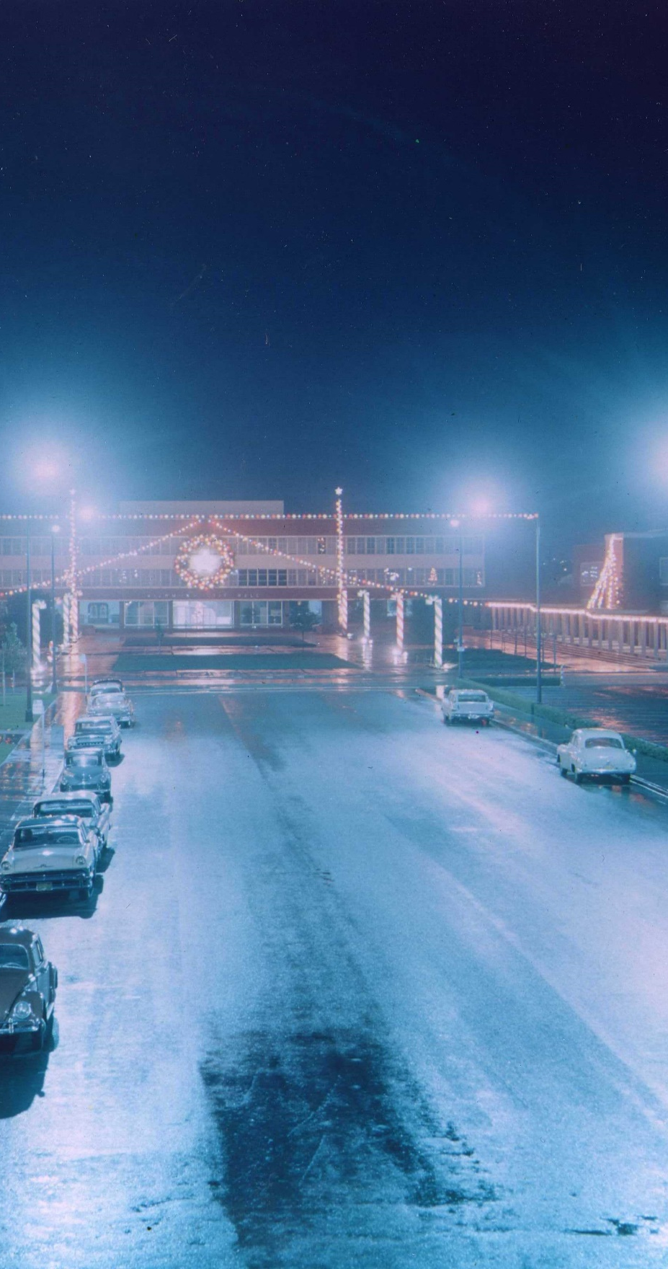
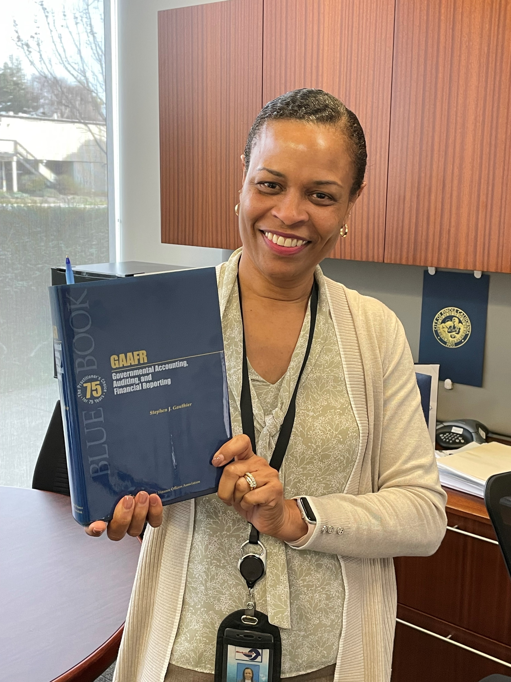
Municipal Finance and Budgeting
Understanding Municipal Finances
01
Operating Budget & 5-Year Capital Improvement Plan
02
03
Budget Calendar
04
Annual Audit
05
Financial Policies
Notes:
Andrea Miller

Slide 2

City Council Goals
Strategic Goal Areas
Improve the quantity and quality of housing, especially low-income housing, and reduce homelessness
Increase revenue and improve economic development
Improve the quality of life, community health, and social determinants of health
Improve public safety
Strengthen the City’s internal infrastructure and processes
Address shoreline issues and ecological sustainability
0
3
Notes:
Andrea Miller

Slide 3
Understanding Municipal Finances
Resources available to assist in understanding the basics of municipal finance in California Cities, Counties, and Special Districts.
The League of California Cities
https://www.calcities.org/
Webinar: What Local Elected Officials Need to Know About Behested Payments
February 12, 2025, 2:00 PM-3:30 PM
0
3
Notes:
Andrea Miller – Resources available to provide a basic understanding of municipal finance sources and uses.
League of California Cities: What Local Elected Officials Need to Know About Behested Payments
February 12, 2025 2:00 PM-3:30 PM – Complementary
A payment is considered "behested" and subject to reporting if it is made: At the request, suggestion, or solicitation of, or made in cooperation, consultation, coordination or concert with the public official; and. For a legislative, governmental or charitable purpose.

Slide 4
Understanding Municipal Finances - Continued
The California Municipal Revenue Sources Handbook
https://californiacityfinance.com/MuniRev2014Ch1plus.pdf
2014 edition is free online
2020 5th Edition is available for $35
Government Finance Officers Association Elected Official’s Guides
https://www.gfoa.org/eog
Understanding the Fiscal Heath of Your Community.
Managing Your Community’s Assets: Capital Planning & Debt
Notes:
Andrea Miller
California Municipal Revenue Sources Handbook. 2014 edition is free online.
A 2020 5th Edition is available for $35.
GFOA Elected Official's Guides:
Understanding the Fiscal Heath of Your Community.
Managing Your Community’s Assets: Capital Planning & Debt

Slide 5
Understanding Municipal Finances - Continued
Accounting:
Generally Accepted Accounting Principles (GAAP)
Governmental Accounting Standards Board (GASB)
California Government Code
Fund Accounting
Governmental Funds:
General Fund
Special Revenue Funds
Debt Service Funds
Capital Projects Funds
Proprietary Funds:
Enterprise Funds
Internal Service Funds
Fiduciary Funds:
Pension and OPEB Trust Funds
Investment Trust Funds
Private-Purpose Trust Funds
0
Notes:
Andrea Miller
Fund accounting is an accounting method that tracks how money is spent and received and ensures that it's used for its intended purpose. It's used by governments and nonprofit organizations.

Slide 6
Understanding Municipal Finances - Continued
Municipal Revenue Types:
Taxes
Property Tax
Sales and Use Tax
Business License Tax
Transient Occupancy Tax
Fees, Charges and Rates
User and Enterprise Fees
Development Impact Fees
Regulatory Fees
Other Revenues
Franchise Fees: Garbage, Gas, Electric, Heat & Power, Transfer Stations, Pipeline
Grants
Federal, State, Local
0
Notes:
Andrea Miller
Revenue is received from taxes versus sales

Slide 7
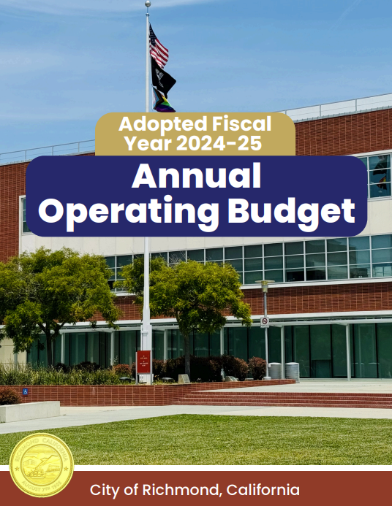
Operating Budget & 5-Year Capital Improvement Plan
Budget must be adopted annually by June 30th RMC 2.61.020
Input from the community and labor unions is incorporated
The Adopted FY 2024-25 Operating Budget is structurally balanced with General Fund revenue and expenditures of $248,935,372
City staff monitors the City’s financials closely and provides quarterly updates
01
01
02
Adopted-FY2024-25-Operating-Budget
& FY2024-25-Through-FY2028-29-Capital-Improvement-Plan
Notes:
Andrea Miller & Mubeen Qadar

Slide 8
Unfunded Liabilities
*CalPERS, $396 Million
**OPEB, $63.4 Million
***Per CalPERS Annual Valuation Report as of June 30, 2024
**Actuarially Valuation Report for Fiscal Year Ending June 30, 2025
Notes:
Andrea Miller & Mubeen Qadar

Slide 9
Budget Calendar
Mid-Year Budget Review – March, 2025
Draft FY2025-26 Budget to City Council – April/May 2025 RMC 2.61.010
Study Session on Draft FY2025-26 Budget – May/June 2025
Adopt FY2025-26 Operating and CIP Budget – June 2025
RMC 2.61.020
Notes:
Andrea Miller & Mubeen Qadar

Slide 10
Annual Audit
California Government Code section 53891 requires every local government agency to submit a report of all financial transactions to the State Controller’s Office based on data from the audited financial statements prepared in accordance with GAAP, and that the report is audited by an independent firm of certified public accountants
The Annual Comprehensive Financial Report (ACFR) contains the basic financial statements (including notes to the financial statements), required supplementary information, and the management’s discussion and analysis of the City. The ACFR is prepared in accordance with generally accepted accounting principles (GAAP) for local governments as established by the Governmental Accounting Standards Board (GASB). The report is designed to highlight changes in the City’s financial condition and practices over time and to allow consistencies between all state, municipal, and other governmental agencies.
Notes:
Andrea Miller & Mubeen Qadar

Slide 11
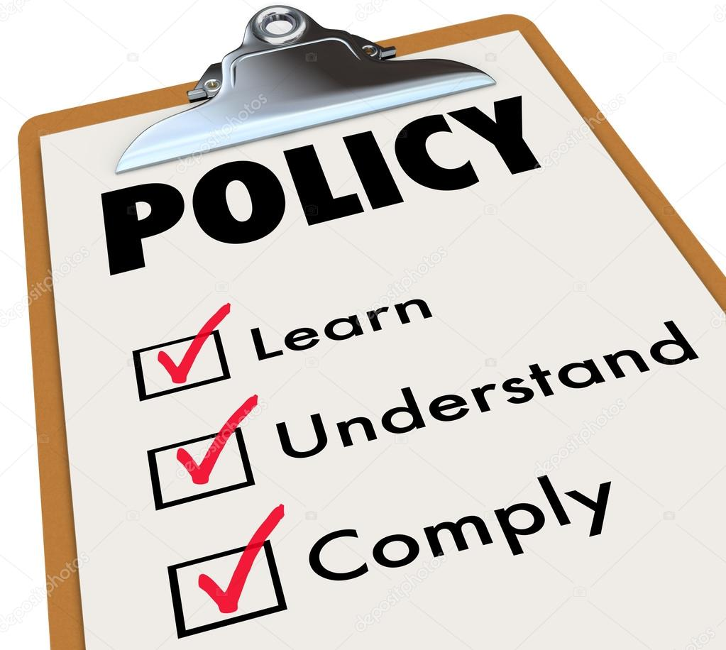
Financial Policies
The City develops financial policies in accordance with generally accepted accounting principles and Government Finance Officers Association recommended best practices.
The Financial Policies are:
Cash Reserve Policy
Debt Policy
Grant Management Policy
Investment Policy
Pension Funding Policy
OPEB Funding Policy
Purchasing Policy
Travel and Expense Policy
Employee Meal and Food Purchase Policy
FasTrak Policy
Guiding Fiscal Policy adopted by City Council April 2021
04
05
GFOA Best Practice: Adopting Financial Policies
Notes:
Andrea Miller & Mubeen Qadar. The Fiscal Policies are: Cash Reserve Policy, Debt Policy, Grant Management Policy, Investment Policy, OPEB Policy,
Adopted by Council April 2021
Guiding Fiscal Policy, adopted by City Council April 2021.

Slide 12


Thank You & Questions!
Notes:
Shasa Curl
We thank you for your time, and will now open up the floor for any questions.

