Slide 1

Overview of the Purchasing and Procurement Process
Finance Department March 11, 2025

Slide 2
Presentation Overview
What Governs the Procurement Process?
Types of Procurements
Timeline for Processing Contracts
BidsOnline System
CAL-Card (P-Card) Program

Slide 3
What Governs the Procurement Process?
Chapter 2.52 of the Richmond Municipal Code
Contracting and Purchasing Procedures
The City Ordinance that governs purchasing
City Council approval is required for all purchases over $10,000
Purchasing Policy
Notes:
Chapter 2.52 Establishes procedures for the purchase of supplies, services and equipment, including formal and informal bidding procedures.
Review list of subsections…
The Purchasing Policy is based on the Chapter 2.52 of the RMC.

Slide 4
Other Ordinances Governing the Procurement Process Cont…
Business Opportunity Ordinance
Local Employment Program Ordinance
Living Wage Ordinance
Ban the Box Ordinance
Sanctuary City Contracting and Investment Ordinance
Limited Liability Corporation Disclosure Resolution
Notes:
Business Opportunity Ordinance: t it is in the best interest of the City of Richmond to have a healthy local business community. The City Council also finds that Richmond businesses, particularly small and nonprofit businesses, often encounter obstacles to obtaining financing and credit; to obtaining bonding and insurance and to maintaining their economic viability. (b) It is the City's policy that first preference for awarding contracts be given to businesses located within its City limits. The public interest is served by continuing to encourage businesses, including small and nonprofit businesses, to locate and remain in Richmond through the provision of a preference to Richmond businesses, Richmond small businesses and Richmond nonprofit businesses in the award of City contracts.

Slide 5
Signature Authority
City Manager Signs Contracts/Agreements Less than or equal to $10,000
Mayor Signs Contracts/Agreements greater than $10,000City
- Council approval is required for all purchases over $10,000
Notes:
City Council should not promise expenditures that are not approved by the City Council as a whole.

Slide 6
Solicitation Thresholds
Requisitioners are responsible to obtain quotes/bids as indicated below:
Less thanks $3,000 – Solicit One Written Quote
Between $3,000 - $5,000 – Solicit Two Written Quotes
Between $5,000 - $50,000 – Solicit Three Written Quotes
Over $50,000 – Formal Sealed Bids/Proposals are Required
Purchases shall not be split to avoid the required procedures or certain dollar limits.
Notes:
City Council should not promise expenditures that are not approved by the City Council as a whole.

Slide 7
Types of Procurement
Small Orders – Informal Solicitations
Competitive Bids – Over $50,000
Request for Proposals (RFP)
Informal – Under $50,000
Formal – Over $50,000
Request for Qualifications (RFQ)
Informal – Under $50,000
Formal – Over $50,000

Slide 8
Small Orders – Informal Solicitations
Procurement of goods or services (<$50,000)
No formal bid specifications or public advertisement required
Quotes may be solicited by fax, email or posted on the City’s BidsOnline System
Less than $3,000 – One Quote
Between $3,000 - $5,000 – Two Quotes
Between $5,000 - $50,000 – Three Quotes

Slide 9
Formal or Informal Solicitations
Informal - Less than or Equal to $50,000
Informal Quotes
Formal – Over $50,000
Solicitation must be posted on the BidsOnline System
Sealed Bids/Proposals
Must be advertised for from 15 – 30 Days,
depending on the complexity of the solicitation
Formal Evaluation

Slide 10
Competitive Bids
Formal Bid Solicitation (>$50,000)
Public Advertisement Required
Public Bid Opening
Receipt of Bids must be sealed bids
Bid Solicitation period 15 - 30 calendar days
Bid Bonds may be required for some bids
Contract awarded to the lowest responsive and responsible bidder meeting City Specifications

Slide 11
Request for Proposals (RFP)
Method used to solicit proposals to implement a new project requiring Professional Services
Used when the City doesn’t have in-house technical experts or resources to implement project or services
RFP defines project objectives and scope of services,
but doesn’t detail every aspect of implementing project
Requires detailed evaluation of proposals by and Evaluation Committee based on criteria stated in the RFP. Low price is not the only factor
Award is made to the highest rated and ranked Respondents

Slide 12
Request for Qualifications (RFQ)
Method used to solicit qualifications from companies who possess a high degree of technical expertise and knowledge in specific disciplines
City “pre-qualifies” companies to build a vendor pool to respond to future individual projects
Evaluation/selection is based on qualifications and technical competence
For Architect & Engineers (A&E), the fee schedule is negotiated later as part of the agreement
Most commonly used for A&E Design contracts and certain categories of consulting

Slide 13

BidsOnline System www.ci.richmond.ca.us/bids
Notes:
The City uses BidsOnline as the mechanism to post RFPs and RFQs. This is a system that ensures the identification, security, and confidentiality of electronic bids or proposals and ensures that the electronic bids remain effectively unopend until the proper time.

Slide 14
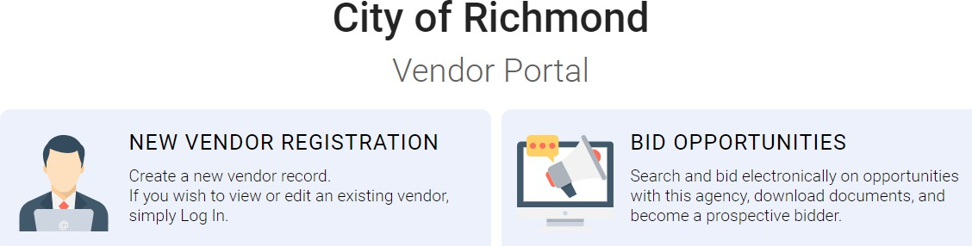
BidsOnline System Cont….

Slide 15
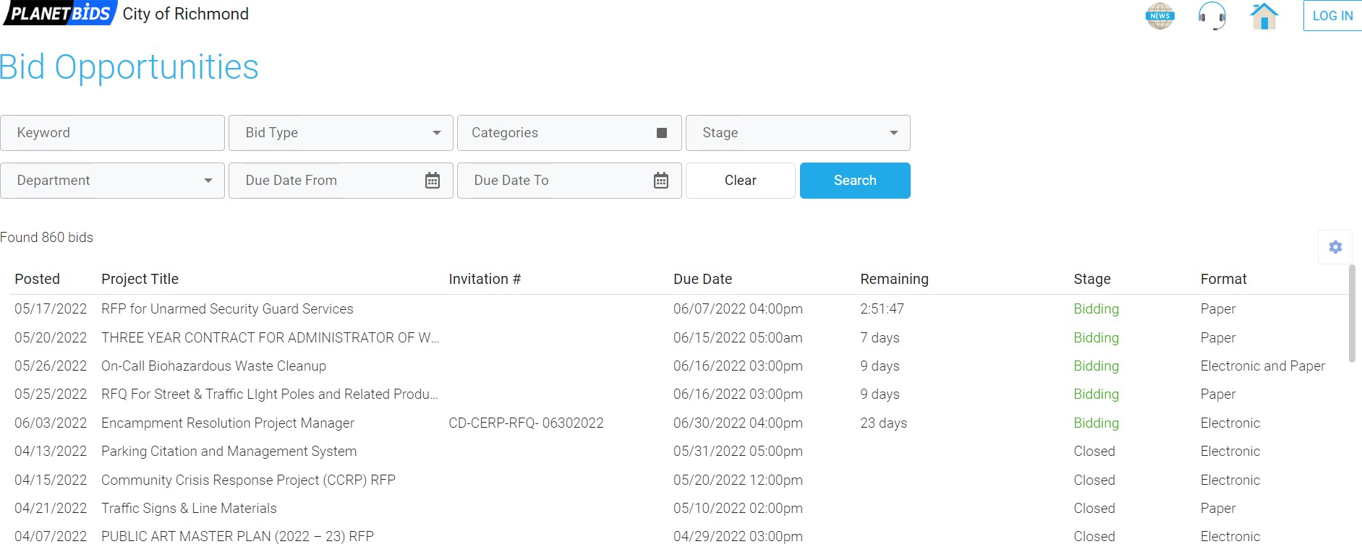
BidsOnline System Cont….

Slide 16
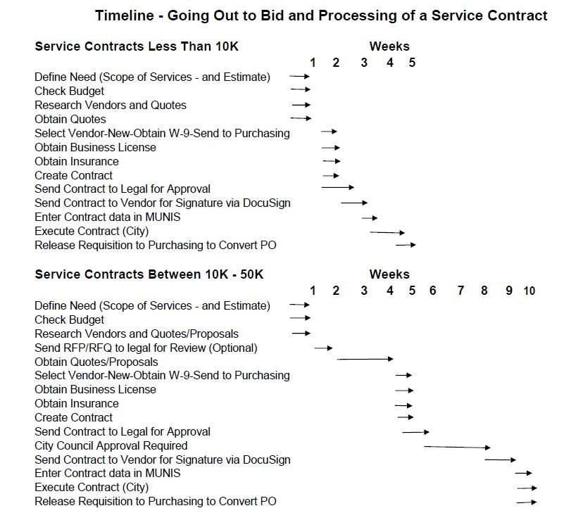

Slide 17
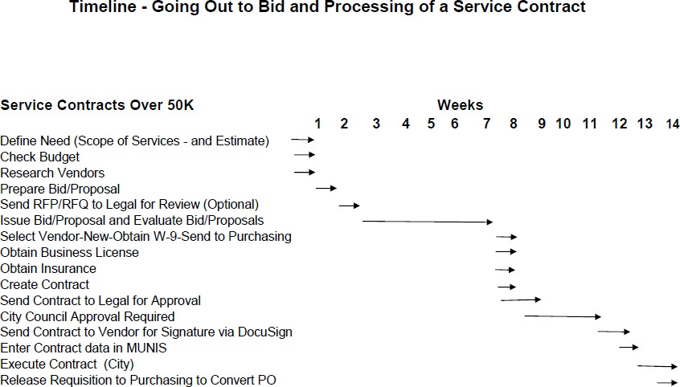

Slide 18
Sole Source Justification Form
A sole source is the only possible source, not a preferred source and not the one who you “know” will offer the lowest price.
Sole Source Justification Form is approved by the Finance Director and City Manager if <$10K by the City Council if >$10K
Council Approval Recommended Action: APPROVE a Sole Source contract with (Name of the Vendor)

Slide 19
Emergency Justification Form
Emergency procurements should be made only:
To preserve life, health or property
Upon a natural disaster
To correct or forestall a shutdown
To maintain essential public services
Other unforeseeable events
NOT because of poor planning

Slide 20
Process After the Emergency
A contract and Purchase Order needs to be created as soon as possible.
If over $10,000, present at the next City Council meeting for Approval
Council Approval Recommended Action: APPROVE an Emergency contract with (Name of the Vendor)

Slide 21
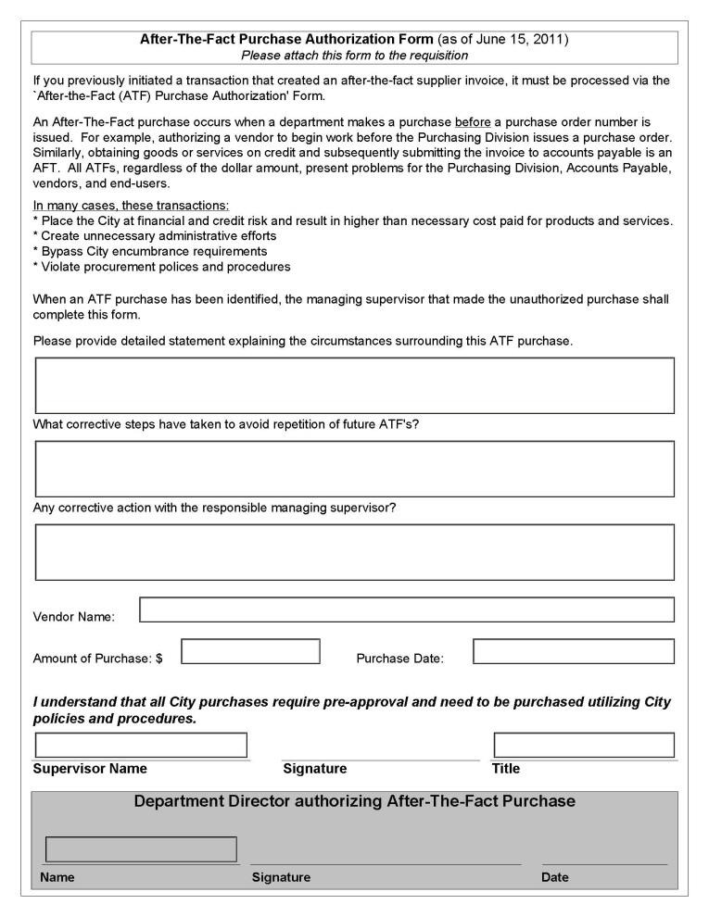
After the Fact Form
Used anytime a department makes a purchase before a contract and purchase order has been processed.

Slide 22
After The Fact Purchases
Place the City at financial and credit risk and result in higher than necessary cost paid for products and services
Create unnecessary administrative efforts
Bypass City encumbrance requirements
Violate procurement policies and procedures

Slide 23
CAL-Card (P-Card) Program
The Procurement Card
Used by a cardholder to expedite the payment of goods of a small dollar amount
No Services on the CAL-Card
For Business Purposes Only
Approving Officials must review and approve
all purchases on the CAL-Card Statement
Avoid Audit Findings

Slide 24
Thank You! For more information visit the City’s Website: Finance > Purchasing > Procurement
Questions?

