Slide 1
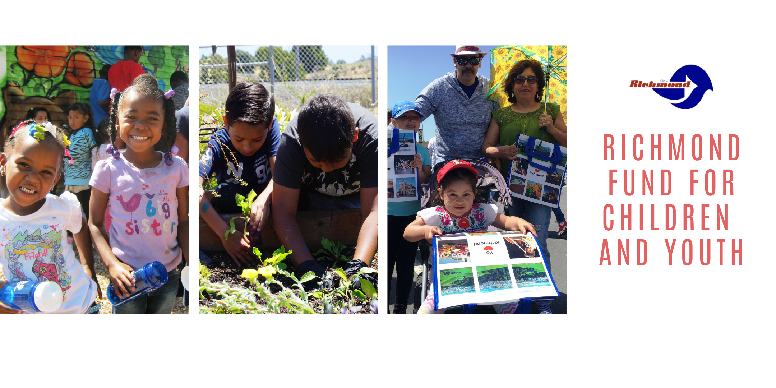

Richmond Department of Children and Youth

Slide 2
OUTLINE
RFCY Overview
Community Input
Grant Process
Grantees
What We Plan to Do
Welcome and Introductions
What We've Done
Questions
Notes:
Here is the outline for today’s presentation. I will provide an overview and then review the eligibility and guideline requirements
Patrick will discuss the components of the application, as well as application submission. Then will we discuss next steps and open it up for questions.
Feel free to place questions in the Q&A Feature and we will do our best to answer them as we go, and if not we can answer them at the end. You can also hold your questions until the end and use the raise hand feature and we will call on you. We encourage questions in Q&A just in case we cannot get to all questions today, we will still have your question and can respond in writing via our FAQ on the website.

Slide 3
Department of Children &Youth Organization Chart
LaShonda White
Deputy City Manager of Community Services
Patrick Seals
Administrative Chief
Nicholas Delgado
Associate Management Analyst
Guadalupe Morales
Associate Management Analyst
Abdul Black
Community Services Technician
Kaitlen Burnom
Management Analyst

Slide 4
Overview

Slide 5
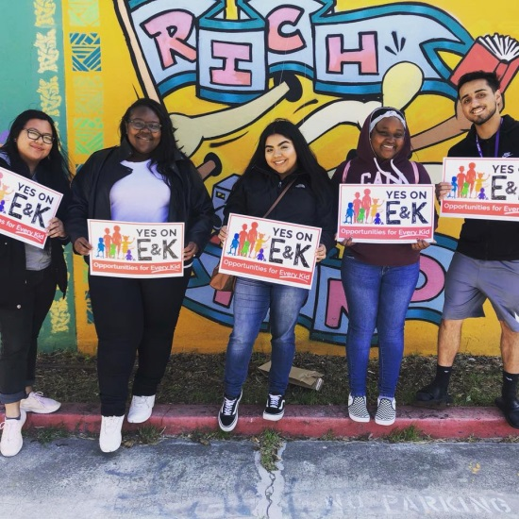
Richmond Kids First Initiative (Measures E & K)
Richmond voters approved Measures E and K, known as the Richmond Kids First Initiative, on June 5, 2018
Established:
Department of Children and Youth and the Richmond Fund for Children and Youth
15-member Oversight Board
Portion of General Fund revenue be set aside to fund youth programs and services
Measure K acts as the revision ordinance for Measure E
Notes:
Establish a sustainable funding stream to:
Provide funding for youth-serving organizations in Richmond and North Richmond (Ages 0-24)
Ensuring the physical, emotional, and mental health of youth
Filling gaps in services and leveraging other resources
Ensuring equitable distribution of resources to all youth
Strengthen the diverse assets and resilience of children, youth and families
Supplement rather than supplant existing funding or programs
Background
The Richmond Kids First Initiative was led by the Invest in Youth Coalition
The Invest in Youth Coalition was a new citywide coalition of youth, individuals, community based organizations and funders working to make Richmond a youth, young adult and family friendly city.
Partners: RYSE Center, Community Health for Asian Americans, The Ed Fund, East Bay Center for the Performing Arts, Healthy Richmond, Asian Pacific Environmental Network (APEN), Youth Enrichment Strategies, Education Matters, Mindful Life Project, Funding the Next Generation, Pogo Park, Building Blocks for Kids.
Additional Endorsers: Supervisor John Gioia, Urban Tilth, California School-Based Health Alliance, Students for Education Reform, Shields-Reid Residents Neighborhood Council, Teachers 4 Social Justice, CBE Action.
Measures
Richmond voters approved Measures E and K on June 5, 2018
Measure H, a Documentary Transfer Tax Initiative, was approved on November 6, 2018

Slide 6
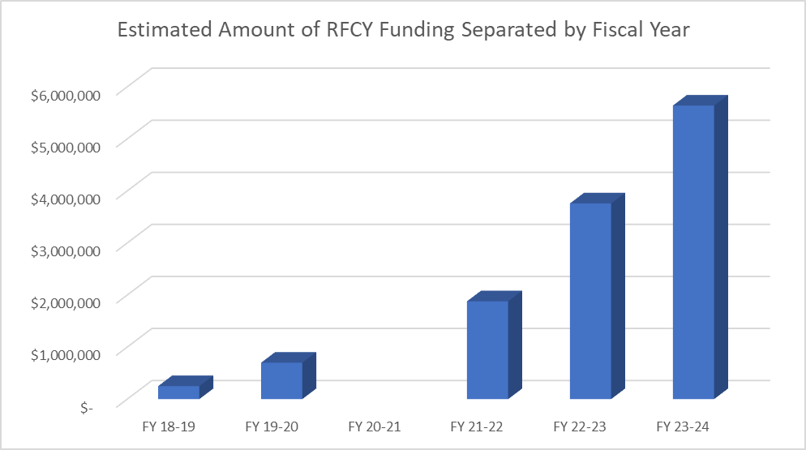
Richmond Fund for Children and Youth
Eligible Uses for the Fund:
Violence Prevention and Response
Education and Job Training
Parent / Guardian Support
Media, Arts, Culture and Technology
Youth and Family Leadership, Organizing and Civic Engagement
Health and Well-Being
Environmental Health and Justice
Outdoor Education and Recreation
Deportation Support
For those experiencing or being threatened with deportation
3%*
3%
2%
2%
1%
1%
$700K
$200K
$700,000
$250,000
The Department of Children and Youth receives 3% of the yearly general fund through FY 27-28
Notes:
Support young people living in Richmond and unincorporated North Richmond
The Fund will prioritize three groups:
Children ages 0 to 12
Youth ages 13 to 17
Disconnected young adults ages 18 to 24
Public agencies and non-profit community-based organizations may receive funding
Richmond Fund for Children and Youth (RFCY)
While we develop we have access to the 250,000 and 700,000 for FY 2018-19, 2019-20, and 2020-21. Will role over if not all used.
10% in place starting FY 2021-22
Beginning in FY 2021-2022 a maximum of 10% of the Fund can be used for costs related to administering the Fund, including staff support, basic infrastructure, support for the agencies administering the contracts, and overhead costs.
Funding
FY 2018-2019: $250,000 from the City’s General Fund (GF)
FY 2019-2020: $700,000 from the City’s GF
FY 2020-2021: Intentional gap year in funding
FY 2021-2022: 1% of the GF (~$1,656,952*)
FY 2022-2023: 2% of the GF (~$3,313,904*)
FY 2023-2024 through FY 2027-2028: 3% of the GF (~$4,970,856)

Slide 7
 | Estimated % of Total Funds
Priority Area 1: Mental Health & Wellness | 20%
Priority Area 2: Education Support & Employment / Training | 20%
Priority Area 3:Out of School time, Afterschool Sports and Enrichment Programming | 20%
Priority Area 4:Violence Prevention | 20%
Priority Area 5: Information, Guidance & Case Management | 10%
Priority Area 6: Basic Needs | 10%
Priority Areas Identified in 2020 Community Needs Assessment

Slide 8
Priority Areas Identified in 2024
Community Needs Assessment
 | Estimated % of Total Funds
Core Need 1: Mental & Behavioral Health | 30%
Core Need 2:Physical Health, Wellness & Access | 20%
Core Need 3:Learning Needs | 30%
Core Need 4: Safety Community & Belonging | 20%
Core Need 5: Connective Supportive Services | Built into application

Slide 9
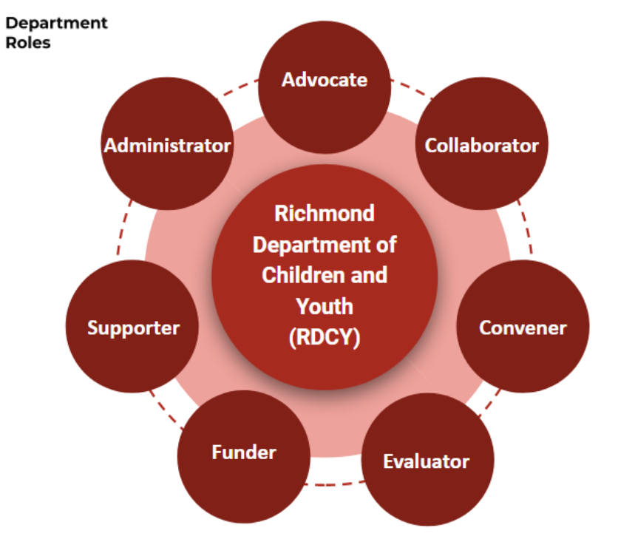
Department of Children and Youth
Supporter | Provide support to the Board (Board recruitment, retention, development, training, agenda setting, meeting facilitation, etc.)
Funder | Develop and administer the grant program in alignment with the Community Needs Assessment and Strategic Investment Plan
Convener | Hold space for City interdepartmental meetings, as well as cross-entity meetings to discuss service delivery, opportunities for collaboration, etc.
Collaborator | Collaborate with various governmental, faith-based, CBOs, philanthropy and community organizations to support work in the community and ensure that children and youth needs are met
Advocate | Work to advocate for services, adequate funding, etc. for children and youth supported by this Fund
Administrator | Administer the grant program in alignment with Measures E & K and Board direction
Evaluator | Develop and implement a process to evaluate and/or support the evaluation of grantees, the grant process, collaborative work with other entities, and the program. Will use the evaluation process to document the collective impact of the Fund
Notes:
Roles of the Department
Supporter: Providing support to the Oversight Board (e.g. assist with board recruitment, retention, development, training, agenda setting, meeting facilitation, etc.)
Funder: Developing and administering the grant program in alignment with the Community Needs Assessment and Strategic Investment Plan
Convener: Holding space for City interdepartmental meetings, as well as cross-entity meetings to discuss service delivery, opportunities for collaboration, etc.
Collaborator: Collaborating with various governmental, faith-based, CBOs, philanthropy and community organizations to support work in the community and ensure that children and youth needs are met
Advocate: Working to advocate for services, adequate funding, etc. for children and youth supported by this Fund
Administrator: Administering the grant program in alignment with Measures E & K and Board direction
Evaluator: Developing and implementing a process to evaluate and/or support the evaluation of grantees, the grant process, collaborative work with other entities, and the program. The Department of Children and Youth will help collect and analyze meaningful data and use the evaluation process to document the collective impact of the Fund.

Slide 10
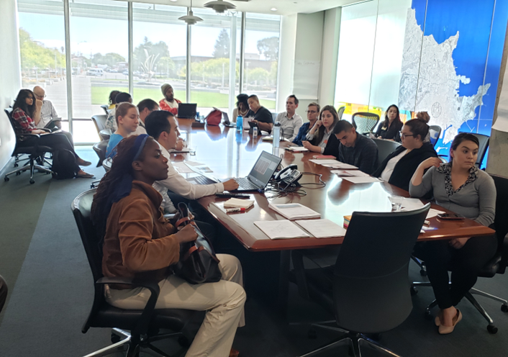
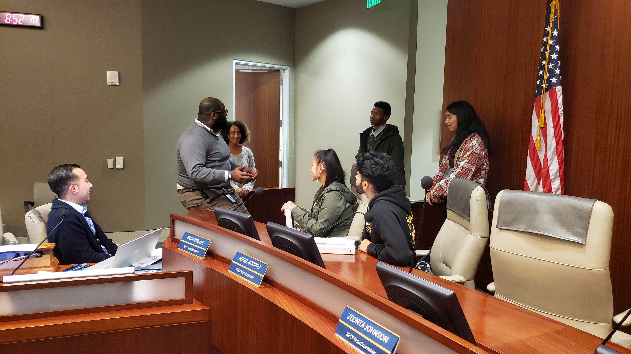
Richmond Fund for Children & Youth Oversight Board
15-member Board
Youth and Adults
Mayor and Councilmember Appointments
2

Slide 11





Oversight Board Guidelines
15 Member Oversight Board (Fund)
Councilmembers: 2 Appointment
One (1) over 24 years of age
One (2) 15- 24 years of age
Mayor: 3 Appointments
At least one (1) 15- 24 years of age
Oversight Board must meet at least six (6) times a year
2

Slide 12
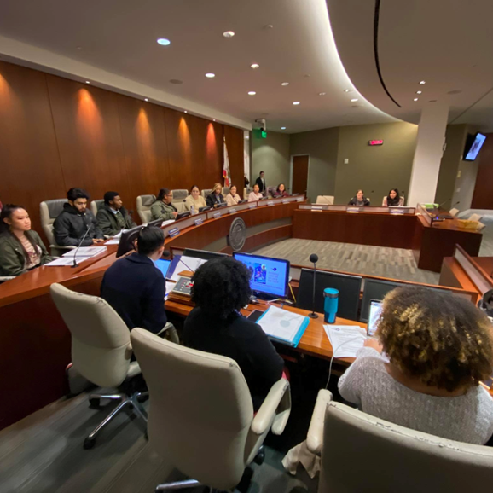
City Council Roles and Responsibilities
Appoint community members to the Richmond Fund for Children and Youth Oversight Board
Receive evaluation of department and fund
Assist in community outreach for community partner engagement
Renew Fund
Review and Approve Awards

Slide 13
Community input

Slide 14
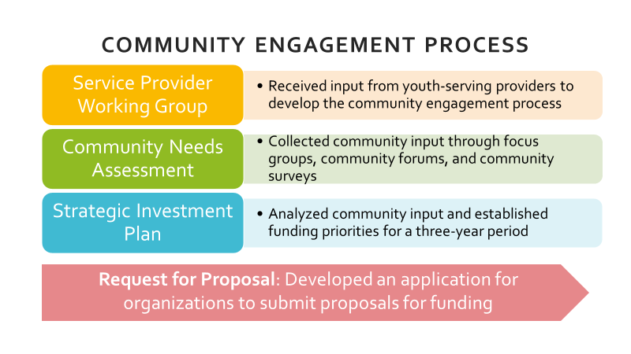

Slide 15
Community Needs Assessments (CNA) and
Strategic Investment Plan (SIP)
CNA identified "gaps" between current conditions and desired conditions, while acknowledging community strengths/resources
The CNA process included:
  Focus groups
  Community forums
  Community surveys
  Share-outs with community partners
The SIP established funding priorities for a three-year period, and a plan for evaluating the Fund and the programs supported by the Fund

Slide 16
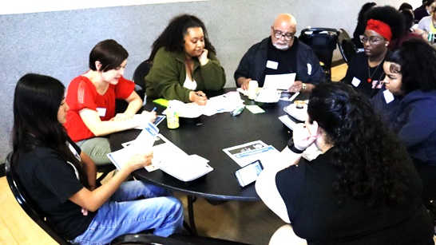
Community Engagement
400+
Insight Interviews
(24 Participants)
Focus Groups
(104 Participants)
Community Survey
(200 Participants)
Visioning Event
(72 Participants)

Slide 17
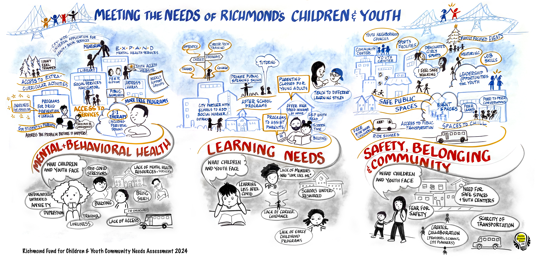

Slide 18
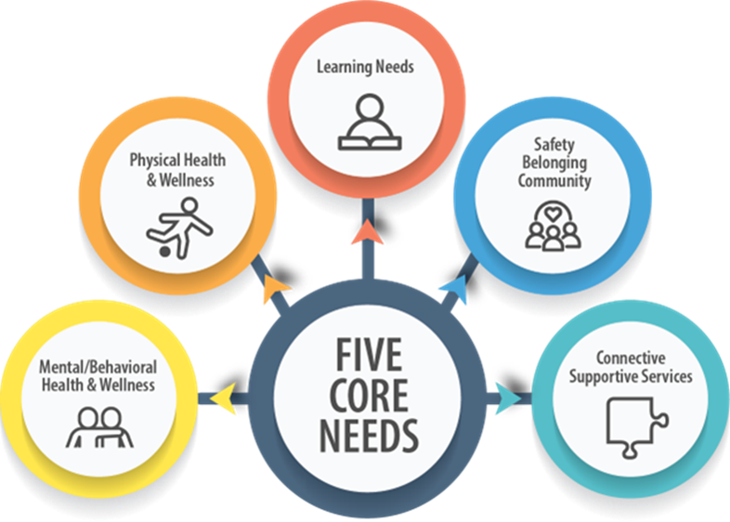
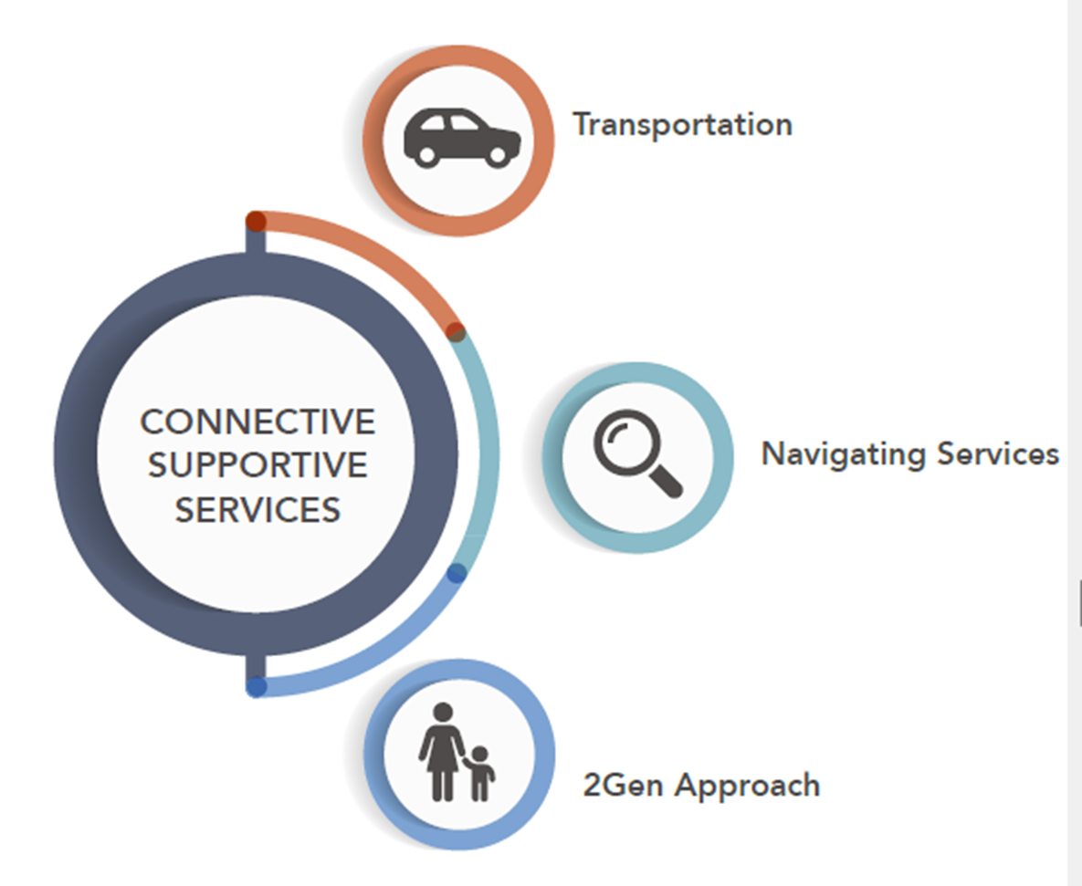
FIVE CORE NEEDS EMERGED

Slide 19
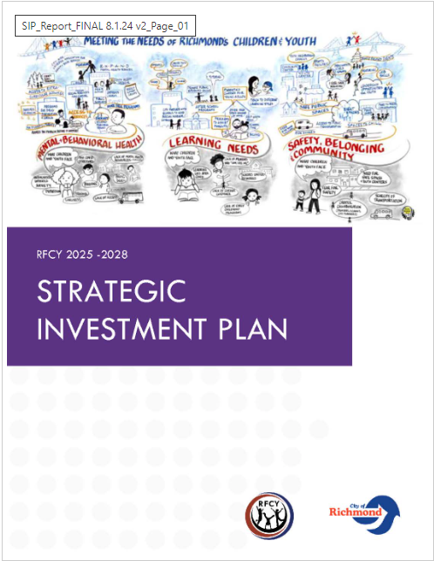
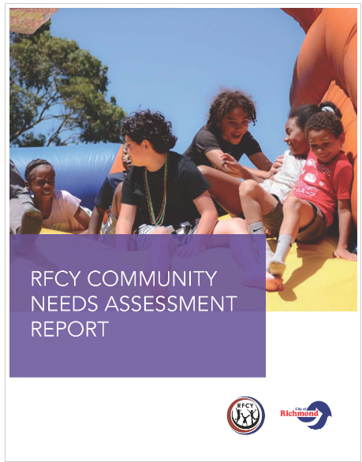
Available on www.ci.richmond.ca.us/RFCYGrants
Additional Resources
Notes:
ID LINK(S) OR HOW TO ACCESS OTHER RESOURCES ON THE RDCY WEBPAGE
Repository of info – will continue to gather relevant info

Slide 20
Grant Process

Slide 21



Appropriate Application Types
Small and Emerging organizations
< $250,000
Single Agency
organizations
> $250,000
Collaborative
at least two organizations, regardless of budget, that want to apply
Notes:
Audited/Reviewed Financials or 990/990Ns
Small and Emerging applicants will be evaluated against each other across all priority areas

Slide 22
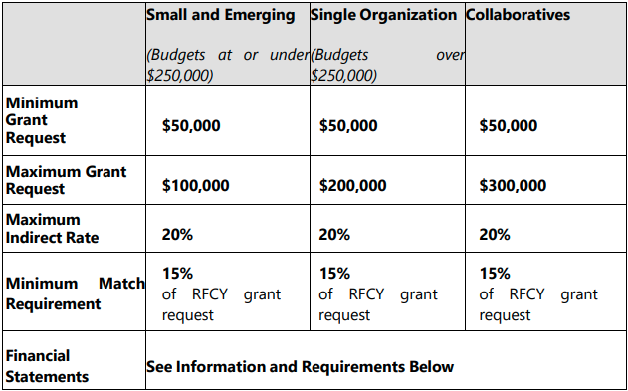
SUMMARY TABLE BY APPLICATION TYPE
Notes:
Although not listed we are strongly recommending that orgs stay within an ask
Sustainability becomes a questions if you ask for more – but more can be request
Examples follow and use 40% threshold

Slide 23

REVIEW PROCESS
City staff reviews applications
RFCY review committee to review and score proposals
Ranking of proposals by priority area
RFCY oversight board review
RFCY oversight board recommendations
Richmond City Council approval and adoption
Notes:
All proposals will be evaluated and scored by a RFCY Review Committee (Committee). Committee members may consist of but are not limited to RFCY Oversight Board
1 - City staff reviews applications for responsiveness, completeness, and satisfaction of eligibility requirements
2 - All eligible applications are forwarded to the RFCY review committee to review and score proposals, based on priority areas
3 - Individual committee members provide scores, and the average of reviewer scores will be used to provide a ranking of proposals by priority area
4 - RFCY staff will provide the committee with the average scores and ranking of proposals
5 - RFCY oversight board will review committee recommendations and will convene to approve funding decisions at a public monthly meeting
6 - The RFCY oversight board will then present their funding recommendations to the Richmond City Council for approval and adoption.

Slide 24
What We’ve Done

Slide 25
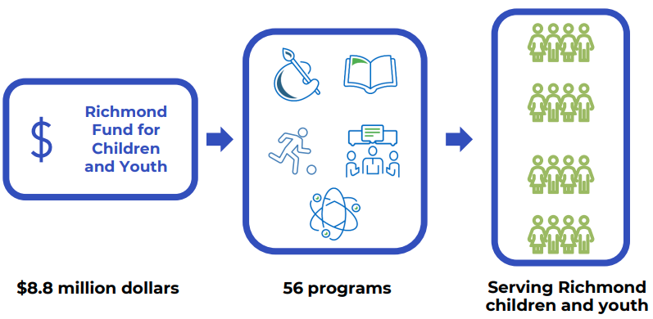

Slide 26
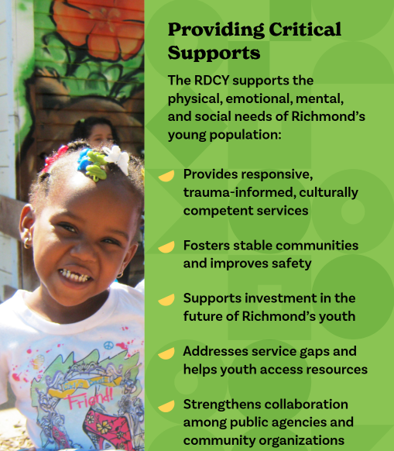
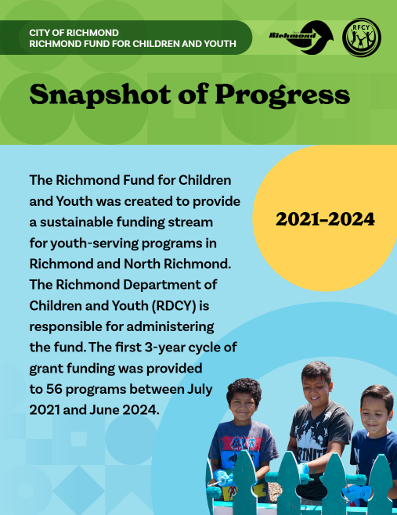

Slide 27
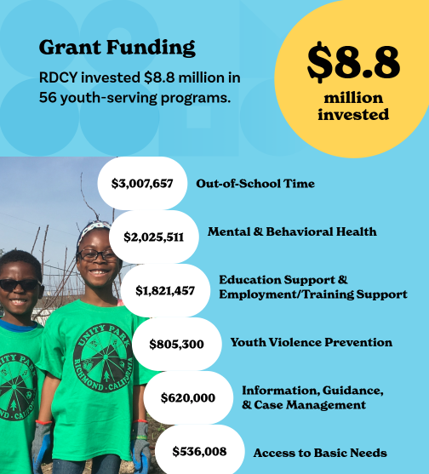
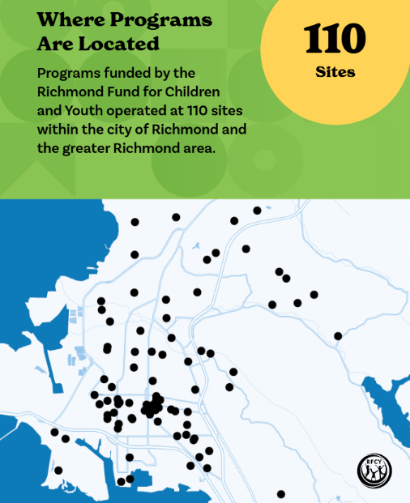

Slide 28
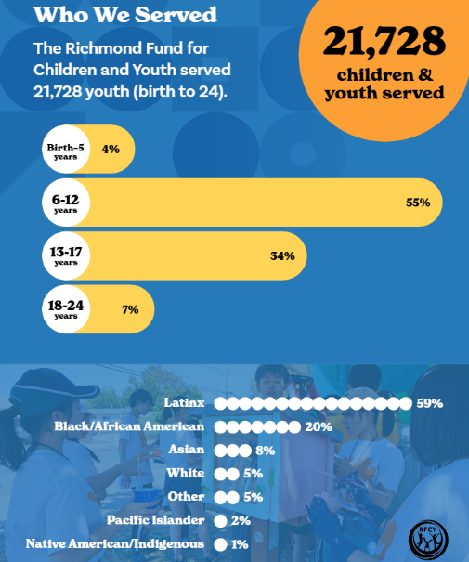
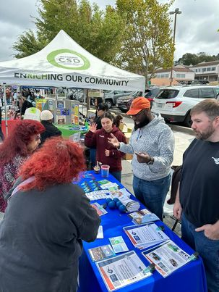

Slide 29
First Cycle of Funding: Performance Measures
Topic | Measure | Benchmark
Program Participation | Number of participants served as a percentage of the program’s projected number of participants | 85%
Service Provision Hours | Number of hours of programming provided as a percentage of the program’s projected hours of programming | 85%
Program Satisfaction | % of surveyed youth who agreed or strongly agreed, “I would recommend this program to a friend.” | >50%
Program Environment | % of surveyed youth who agreed or strongly agreed, “I feel physically safe when I am at this program.” | >70%
Caring Adults | % of surveyed youth who agreed or strongly agreed, “There is an adult at this program who cares about me.” | >70%
Sense of Belonging | % of surveyed youth who agreed or strongly agreed, “I have a strong sense of belonging to a community at this program.” | >50%

Slide 30
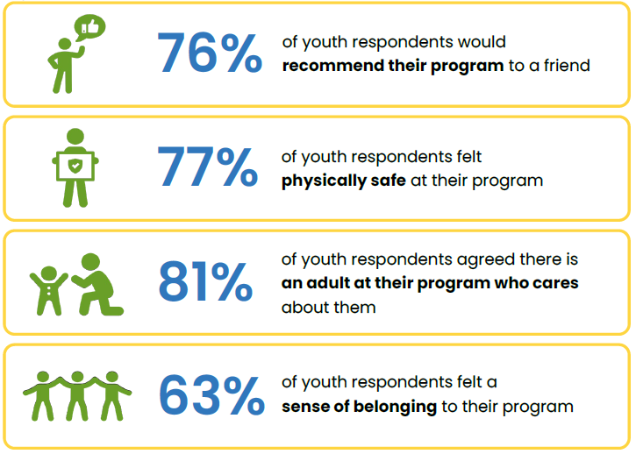
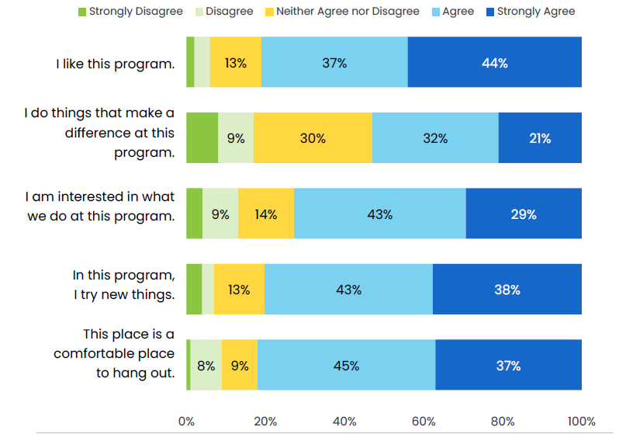
First Cycle of Funding: Performance Measures Cont.

Slide 31
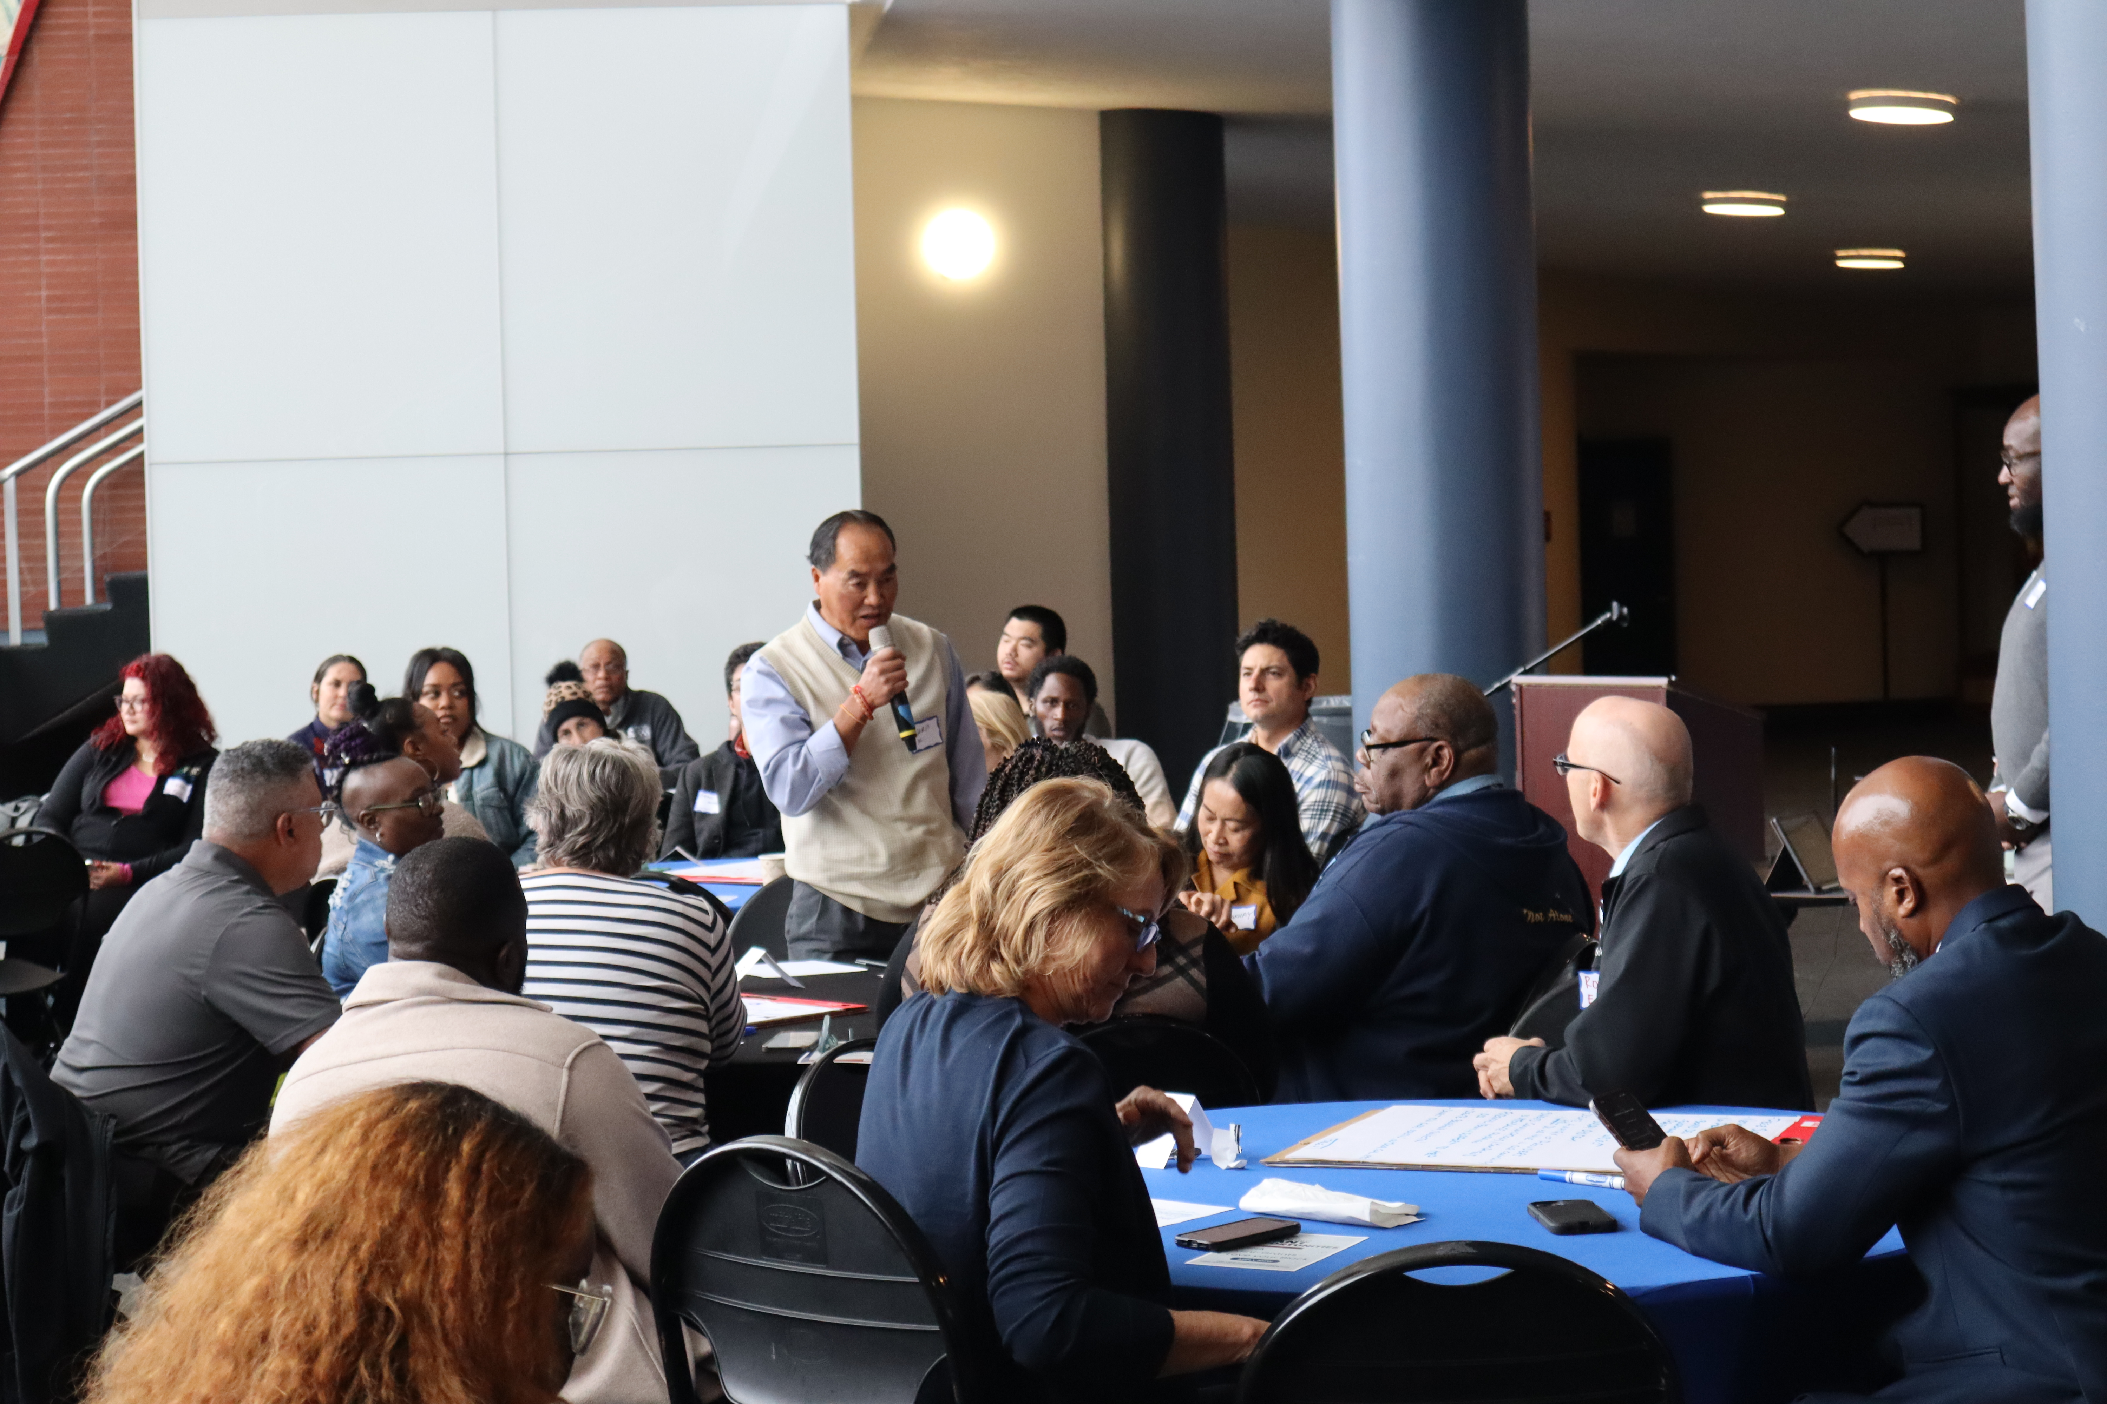
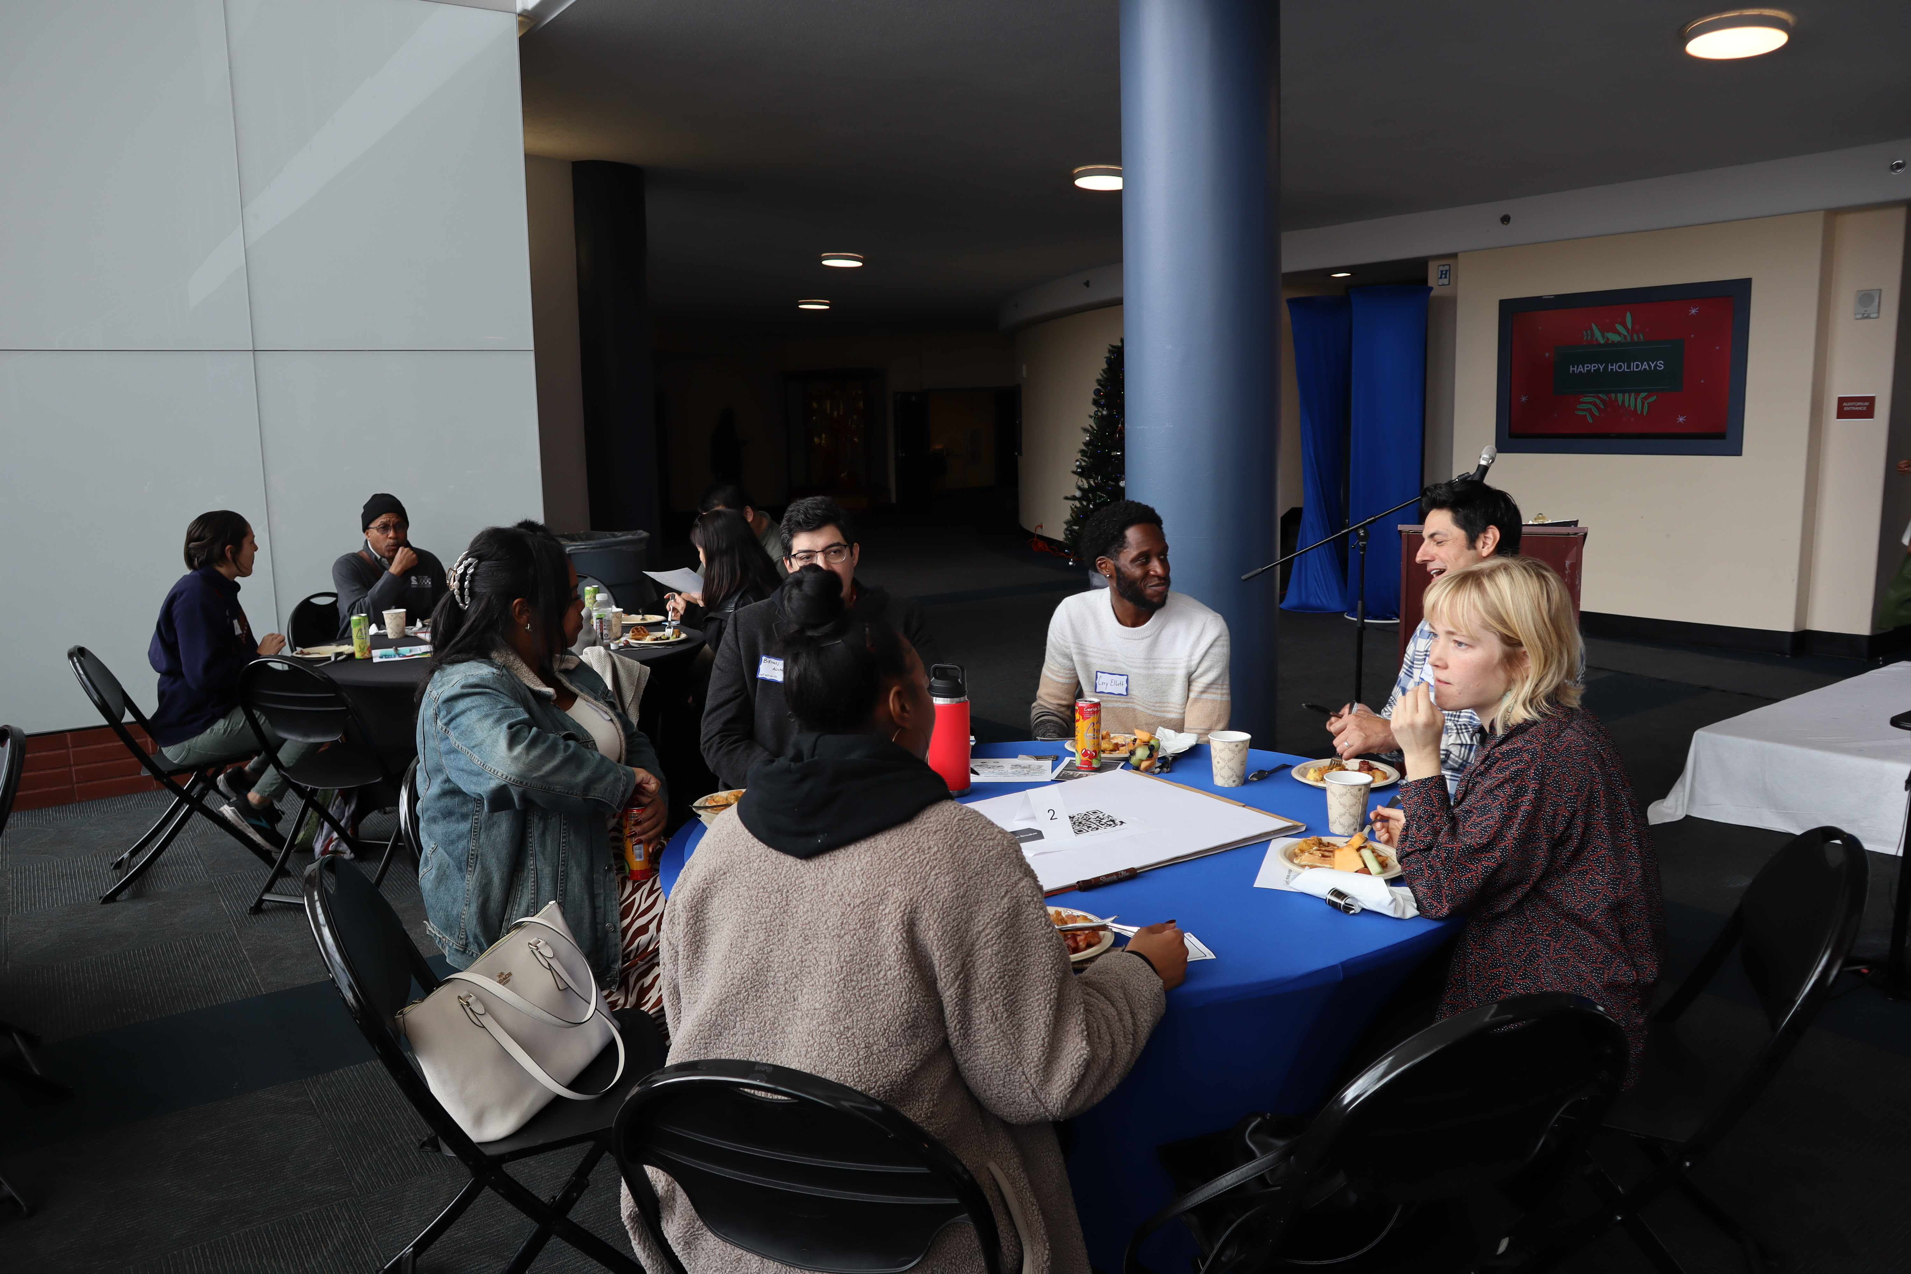
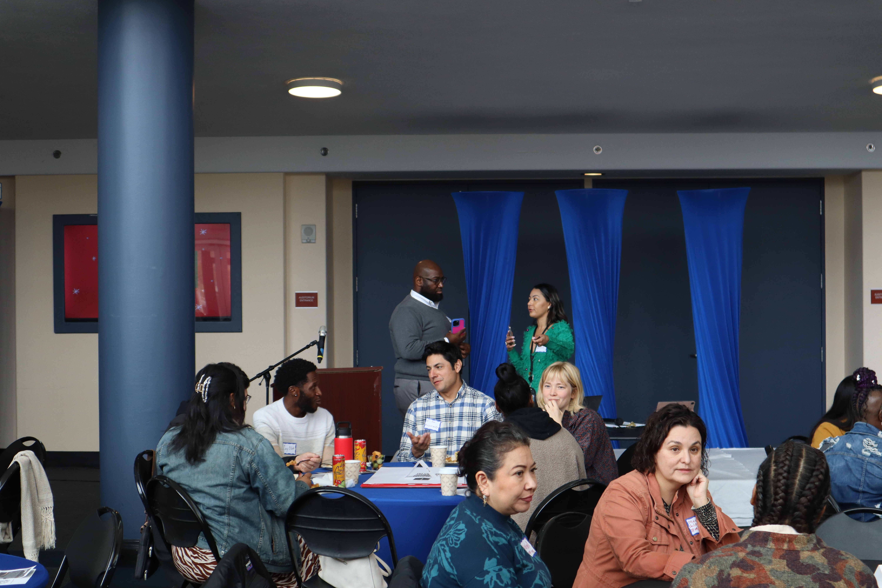
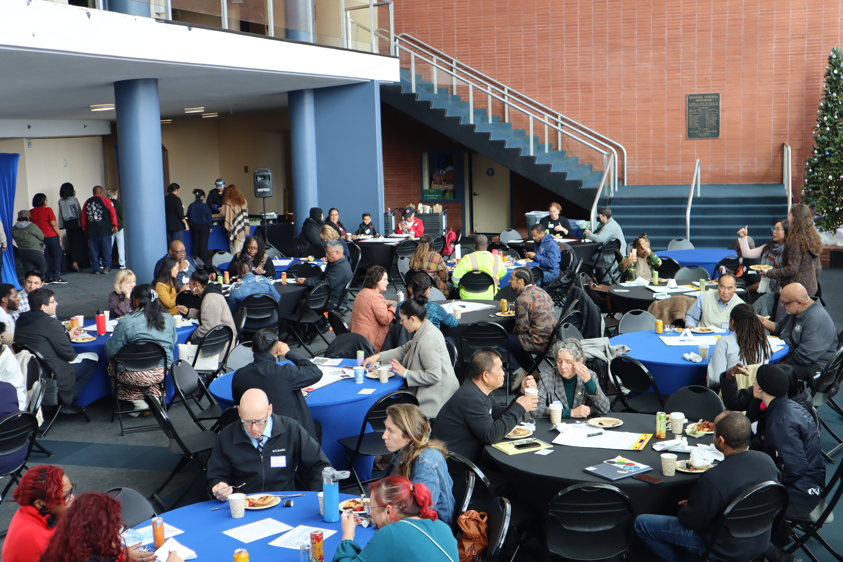
Service Provider Working Group
In December, SPWG reconvened and brought 50+ Service Providers together for a holiday brunch to discuss the future of the group in Richmond
Broad cross-section of youth-serving providers
Use their knowledge of the Richmond community to serve as subject matter experts to provide input to the Oversight Board and Department

Slide 32
FY 2021-2022
Grantees

Slide 33
FY 21-22 Grant Funding amount Recommendations
Priority Area | Grant Award Amount
1. Behavioral Health: Mental Health and Wellness | $335,000
2. Education Support and Employment Training/Support | $445,150
3. Out of School Time, Afterschool Sports, and Enrichment Programming | $429,750
4. Violence Prevention | $200,100
5. Information, Guidance, and Case Management | $110,000
6. Basic Needs | $100,000
TOTAL PROPOSED ALLOCATION | $1,620,000

Slide 34
1. Mental Health and Wellness
Mental Health and Wellness Recommendations
Organization Name | Requested Amount | Grant Award Amount
Desarrollo Familiar, Inc. (Familias Unidas) (Single Agency) | $135,000 | $135,000
Early Childhood Mental Health Program (Single Agency) | $125,000 | $100,000
Seneca Family of Agencies (Single Agency) | $150,000 | $100,000
TOTAL | $410,000 | $335,000

Slide 35
2. Education Support and Employment Training/Support
Education Support and Employment Training/Support Recommendations
Organization Name | Requested Amount | Grant Award Amount
College is Real (Single Agency) | $85,000 | $85,000
Urban Tilth (Single Agency) | $100,000 | $80,000
Employment & Training - RichmondBUILD | $150,000 | $125,000
Richmond Promise (Collaboration: Health Career Connections & City Of Richmond – Economic Development) | 180,606 | $132,650
Black Firefighters Association (Small & Emerging) | $37,000 | $22,500
TOTAL | $552,606 | $445,150

Slide 36
3. Out of School Time, Afterschool Sports, and Enrichment Programming
Out of School Time, Afterschool Sports, and Enrichment Programming Recommendations
Organization Name | Requested Amount | Grant Award Amount
Youth Code Now (Small & Emerging) | $54,250 | $54,250
West County Digs (Small & Emerging) | $70,000 | $45,500
East Bay Center for the Performing Arts (Single Agency) | $100,000 | $100,000
RYSE (Single Agency) | $75,000 | $75,000
Rosie the Riveter Trust (Collaboration: Boys & Girls Club, National Park Service) | 100,000 | $65,000
Community Services Department - Recreation (Collaboration: EdFund) | 120,000 | $90,000
TOTAL | $519,250 | $429,750

Slide 37
4. Violence Prevention
Violence Prevention Recommendations
Organization Name | Requested Amount | Grant Award Amount
Project Avary (Single Agency) | $100,000 | $65,100
Community Violence Solutions (Single Agency) | $150,000 | $100,000
Child Abuse Prevention Council of Contra Costa County (Single Agency) | $40,000 | $35,000
TOTAL | $290,000 | $200,100

Slide 38
5. Information, Guidance & Case Management
Information, Guidance, and Case Management Recommendations
Organization Name | Requested Amount | Grant Award Amount
Contra Costa Family Justice Alliance (Single Agency) | $150,000 | $110,000
TOTAL | $150,000 | $110,000

Slide 39
6. Basic Needs
Basic Needs Recommendations
Organization Name | Requested Amount | Grant Award Amount
Richmond Promise (Collaboration: Tech Exchange) | $100,000 | $75,000
18 Reasons (Single Agency) | $50,000 | $25,000
TOTAL | $150,000 | $100,000

Slide 40
FY 2022-2023
Grantees

Slide 41
Grant Funding amount Recommendations
Priority Area | Estimated Total of Funds | Grant Award Amount | Difference/Balance
1. Behavioral Health: Mental Health and Wellness | 20% = $320,000 | $309,588 | 10,412
2. Education Support and Employment Training/Support | 20% = $320,000 | $170,000 | 150,000
3. Out of School Time, Afterschool Sports, and Enrichment Programming | 20% = $320,000 | $671,250 | -351,250
4. Violence Prevention | 20% = $320,000 | $65,475
5. Information, Guidance, and Case Management | 10% = $170,000 | $118,004 | 51,996
6. Basic Needs | 10% = $170,000 | $100,000 | 70,000
TOTAL PROPOSED ALLOCATION | 100% = $1.62M | $1,434,317 | $185,683

Slide 42
1. Mental Health and Wellness
Mental Health and Wellness Recommendations
Organization Name | Requested Amount | Grant Award Amount
Mindful Life Project (Single Agency) | $60,000 | $60,000
New Life Movement (Single Agency) | $150,000 | $100,000
Bay Area Community Resources (Single Agency) | $149,588 | $149,588
TOTAL | $359,588.00 | $309,588.00

Slide 43
2. Education Support and Employment Training/Support
Education Support and Employment Training/Support Recommendations
Organization Name | Requested Amount | Grant Award Amount
Richmond Art Center (Single Agency) | $40,000 | $40,000
The Watershed Project (Single Agency) | $100,000 | $10,000
Things That Creep (Single Agency) | $30,000 | $30,000
TOTAL | $170,000.00 | $170,000.00

Slide 44
3. Out of School Time, Afterschool Sports, and Enrichment Programming
Out of School Time, Afterschool Sports, and Enrichment Programming Recommendations
Organization Name | Requested Amount | Grant Award Amount
The Watershed Project | $50,000 | $50,000
Scientific Adventures for Girls | $65,000 | $65,000
The Practice Space | $100,000 | $100,000
Pogo Park | $150,000 | $150,000
Aim High for High School | $150,000 | $150,000
Rosie the Riveter Trust (Collaboration: National Park Service) | $86,250 | $86,250
D.R.E.A.M. Financial Academy (Collaboration: Just Imagine Kidz) | $40,000 | $40,000
Oshiana Unique Thompkins Foundation (Small and Emerging) | $30,000 | $30,000
TOTAL | $671,250.00 | $671,250.00

Slide 45
4. Violence Prevention
Violence Prevention Recommendations
Organization Name | Requested Amount | Grant Award Amount
Fresh Lifelines for Youth, Inc. | $65,475 | $65,475
TOTAL | $65,475.00 | $65,475.00

Slide 46
5. Information, Guidance & Case Management
Information, Guidance, and Case Management Recommendations
Organization Name | Requested Amount | Grant Award Amount
Fresh Approach | $68,004 | $68,004.00
Greater Richmond Interfaith Program | $50,000 | $50,000
TOTAL | $118,004.00 | $118,004.00

Slide 47
6. Basic Needs
Basic Needs Recommendations
Organization Name | Requested Amount | Grant Award Amount
Contra Costa Youth Service Bureau | $100,000 | $80,000
Greater Richmond Interfaith Program | $50,000 | $20,000
TOTAL | $150,000.00 | $100,000.00

Slide 48
FY 2023-2024
Grantees

Slide 49
Priority Area 1: Mental Health and Wellness
Mental Health and Wellness
Organization Name | Requested Amount | Grant Renewal Recommendation
West County Mandarin School PTA (Small and Emerging) | $81,750 | $41,000
Greater Richmond Interfaith Program (Collaboration) | $170,000 | $85,000
Richmond Community Foundation (Single Agency) | $125,335 | $125,335
Bay Area Community Resources (Single Agency) | $150,000 | $150,000
TOTAL | $527,085 | $401,335

Slide 50
Priority Area 2: Education Support and Employment Training
Education Support and Employment Training/Support
Organization Name | Requested Amount | Grant Renewal Recommendation
Bridges from School to Work (Single Agency) | $75,000 | $50,000
Improve Your Tomorrow (Single Agency) | $150,000 | $75,000
Healthy Contra Costa (Collaborative) | $192,288.31 | $96,000
City of Richmond, Employment and Training Department (Single Agency) | $150,000 | $150,000
Richmond Public Library (Single Agency) | $150,000 | $150,000
TOTAL | $717,288.31 | $521,000

Slide 51
Priority Area 3: Out of School time, Afterschool Sports, and Enrichment Programming
Out of School Time, Afterschool Sports, and Enrichment Programming
Organization Name | Requested Amount | Grant Renewal Recommendation
Social Progress Inc. (Small and Emerging) | $30,000 | $15,000
Easter Hill United Methodist Church (Small and Emerging) | $39,000 | $20,000
ABLE Community Development Foundation (Small and Emerging) | $45,707 | $45,707
City of Richmond, Community Services – Recreation (Single Agency) | $61,500 | $61,500
Envisioneers Inc. (Single Agency) | $80,000 | $80,000
Community Education Partnerships (Single Agency) | $134,700 | $134,707
TOTAL | $390,907 | $356,907

Slide 52
Priority Area 4: Violence Prevention
Violence Prevention
Organization Name | Requested Amount | Grant Renewal Recommendation
Richmond Police Activities League (Single Agency) | $74,050 | $74,050
TOTAL | $74,050 | $74,050

Slide 53
Priority Area 6: Information Guidance and Case Management
Information, Guidance, and Case Management
Organization Name | Requested Amount | Grant Renewal Recommendation
Youth Finance Institute of America (Small and Emerging) | $30,000 | $30,000
Richmond Neighborhood Housing Services (Collaborative) | $127,429 | $60,000
TOTAL | $157,429 | $90,000

Slide 54
What We plan to Do

Slide 55
FY 25-28 Grant awards

Slide 56
RFP Process
Released September 3, 2024
Final due October 6, 2024
92 applications received (80 passed threshold review)
$19 million in grant requests

Slide 57
Core Need 1: Mental Health & Wellness
Mental Health & Wellness
Organization Name | Requested Amount | Grant Renewal Recommendation
Bay Area Community Resources S | $200,000 | $200,000
Bay Area Girls Club* E | $50,000 | $50,000
Black Neighborhood* E | $60,000 | $60,000
Child Abuse Prevention Council S | $51,200 | $51,200
City of Richmond, Office of Neighborhood Safety* C | $300,000 | $300,000
Contra Costa Family Justice Alliance* S | $200,000 | $200,000
Desarrollo Familiar* S | $200,000 | $200,000
Greater Richmond Interfaith Program* C | $300,000 | $300,000
Latina Center* C | $200,000 | $200,000
Mindful Life Project* S | $150,000 | $150,000
West Contra Costa Unified School District* C | $300,000 | $300,000
TOTAL for 11 Organizations | $2,011,200 | $2,011,200

Slide 58
Core Need 2: Physical Health & Access
Physical Health & Access
Organization Name | Requested Amount | Grant Renewal Recommendation
18 Reasons S | $200,000 | $200,000
Growing Together, Bay Area S | $190,840 | $190,840
Pogo Park* S | $200,000 | $200,000
Project Avary S | $200,000 | $200,000
Richmond Outdoors Coalition* C | $300,000 | $300,000
Richmond Steelers* E | $80,000 | $80,000
Summer Search* S | $50,000 | $50,000
YES Nature to Neighborhoods* S | $199,974 | $199,974
TOTAL for 8 Organizations | $1,420,814 | $1,420,814

Slide 59
Core Need 3: Learning Needs
Learning Needs
Organization Name | Requested Amount | Grant Renewal Recommendation
City of Richmond, Employment & Training * C | $300,000 | $300,000
City of Richmond, Recreation Dept * C | $300,000 | $300,000
Fresh Approach S | $200,000 | $200,000
Hidden Genius Project * S | $200,000 | $200,000
Practice Space * S | $200,000 | $200,000
Richmond Freedom School (Ed Fund)* S | $200,000 | $200,000
Richmond Promise * C | $218,475 | $218,475
Richmond Public Library | $200,000 | $200,000
RYSE * S | $200,000 | $200,000
Things That Creep * E | $100,000 | $100,000
Watershed Project * S | $125,000 | $125,000
TOTAL for 11 Organizations | $2,243,475 | $2,243,475

Slide 60
Core Need 4: Safety, Community & Belonging
Safety, Community & Belonging
Organization Name | Requested Amount | Grant Renewal Recommendation
Big Brothers Big Sisters, Bay Area S | $60,000 | $60,000
East Bay Center for the Performing Arts* C | $300,000 | $300,000
Fresh Lifelines for Youth* S | $101,790 | $101,790
Nurturing Independence Through Artistic Development* S | $58,556 | $58,556
Richmond High School Music Department* C | $300,000 | $300,000
Summer Search* S | $173,000 | $173,000
Touch of New Life* E | $66,000 | $66,000
TOTAL for 7 Organizations | $1,059,346 | $1,059,346

Slide 61
What We Plan To Do: Current & Future
An Evaluation of the Richmond Fund for Children and Youth (RFCY)
Technical Assistance and Capacity-Building
Relationship Management (CRM) System
Direct Services Grant for FY25-26

Slide 62
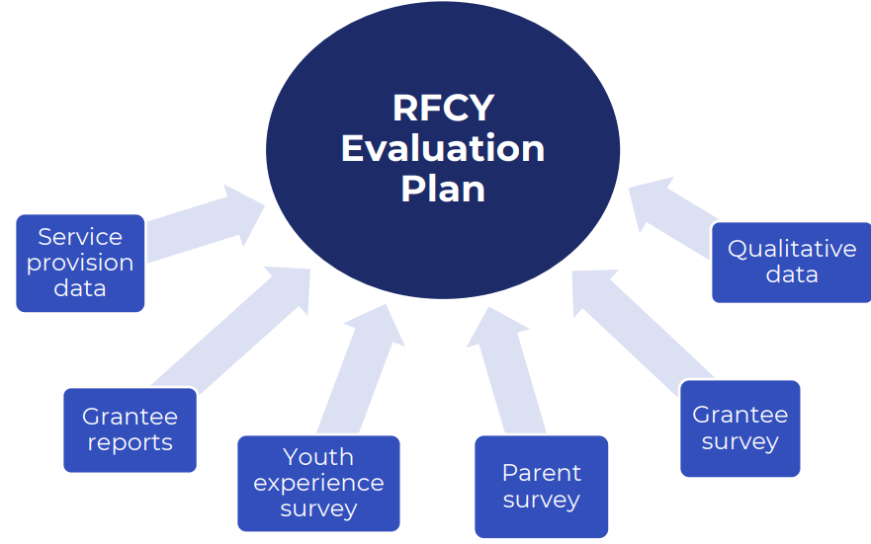

Slide 63
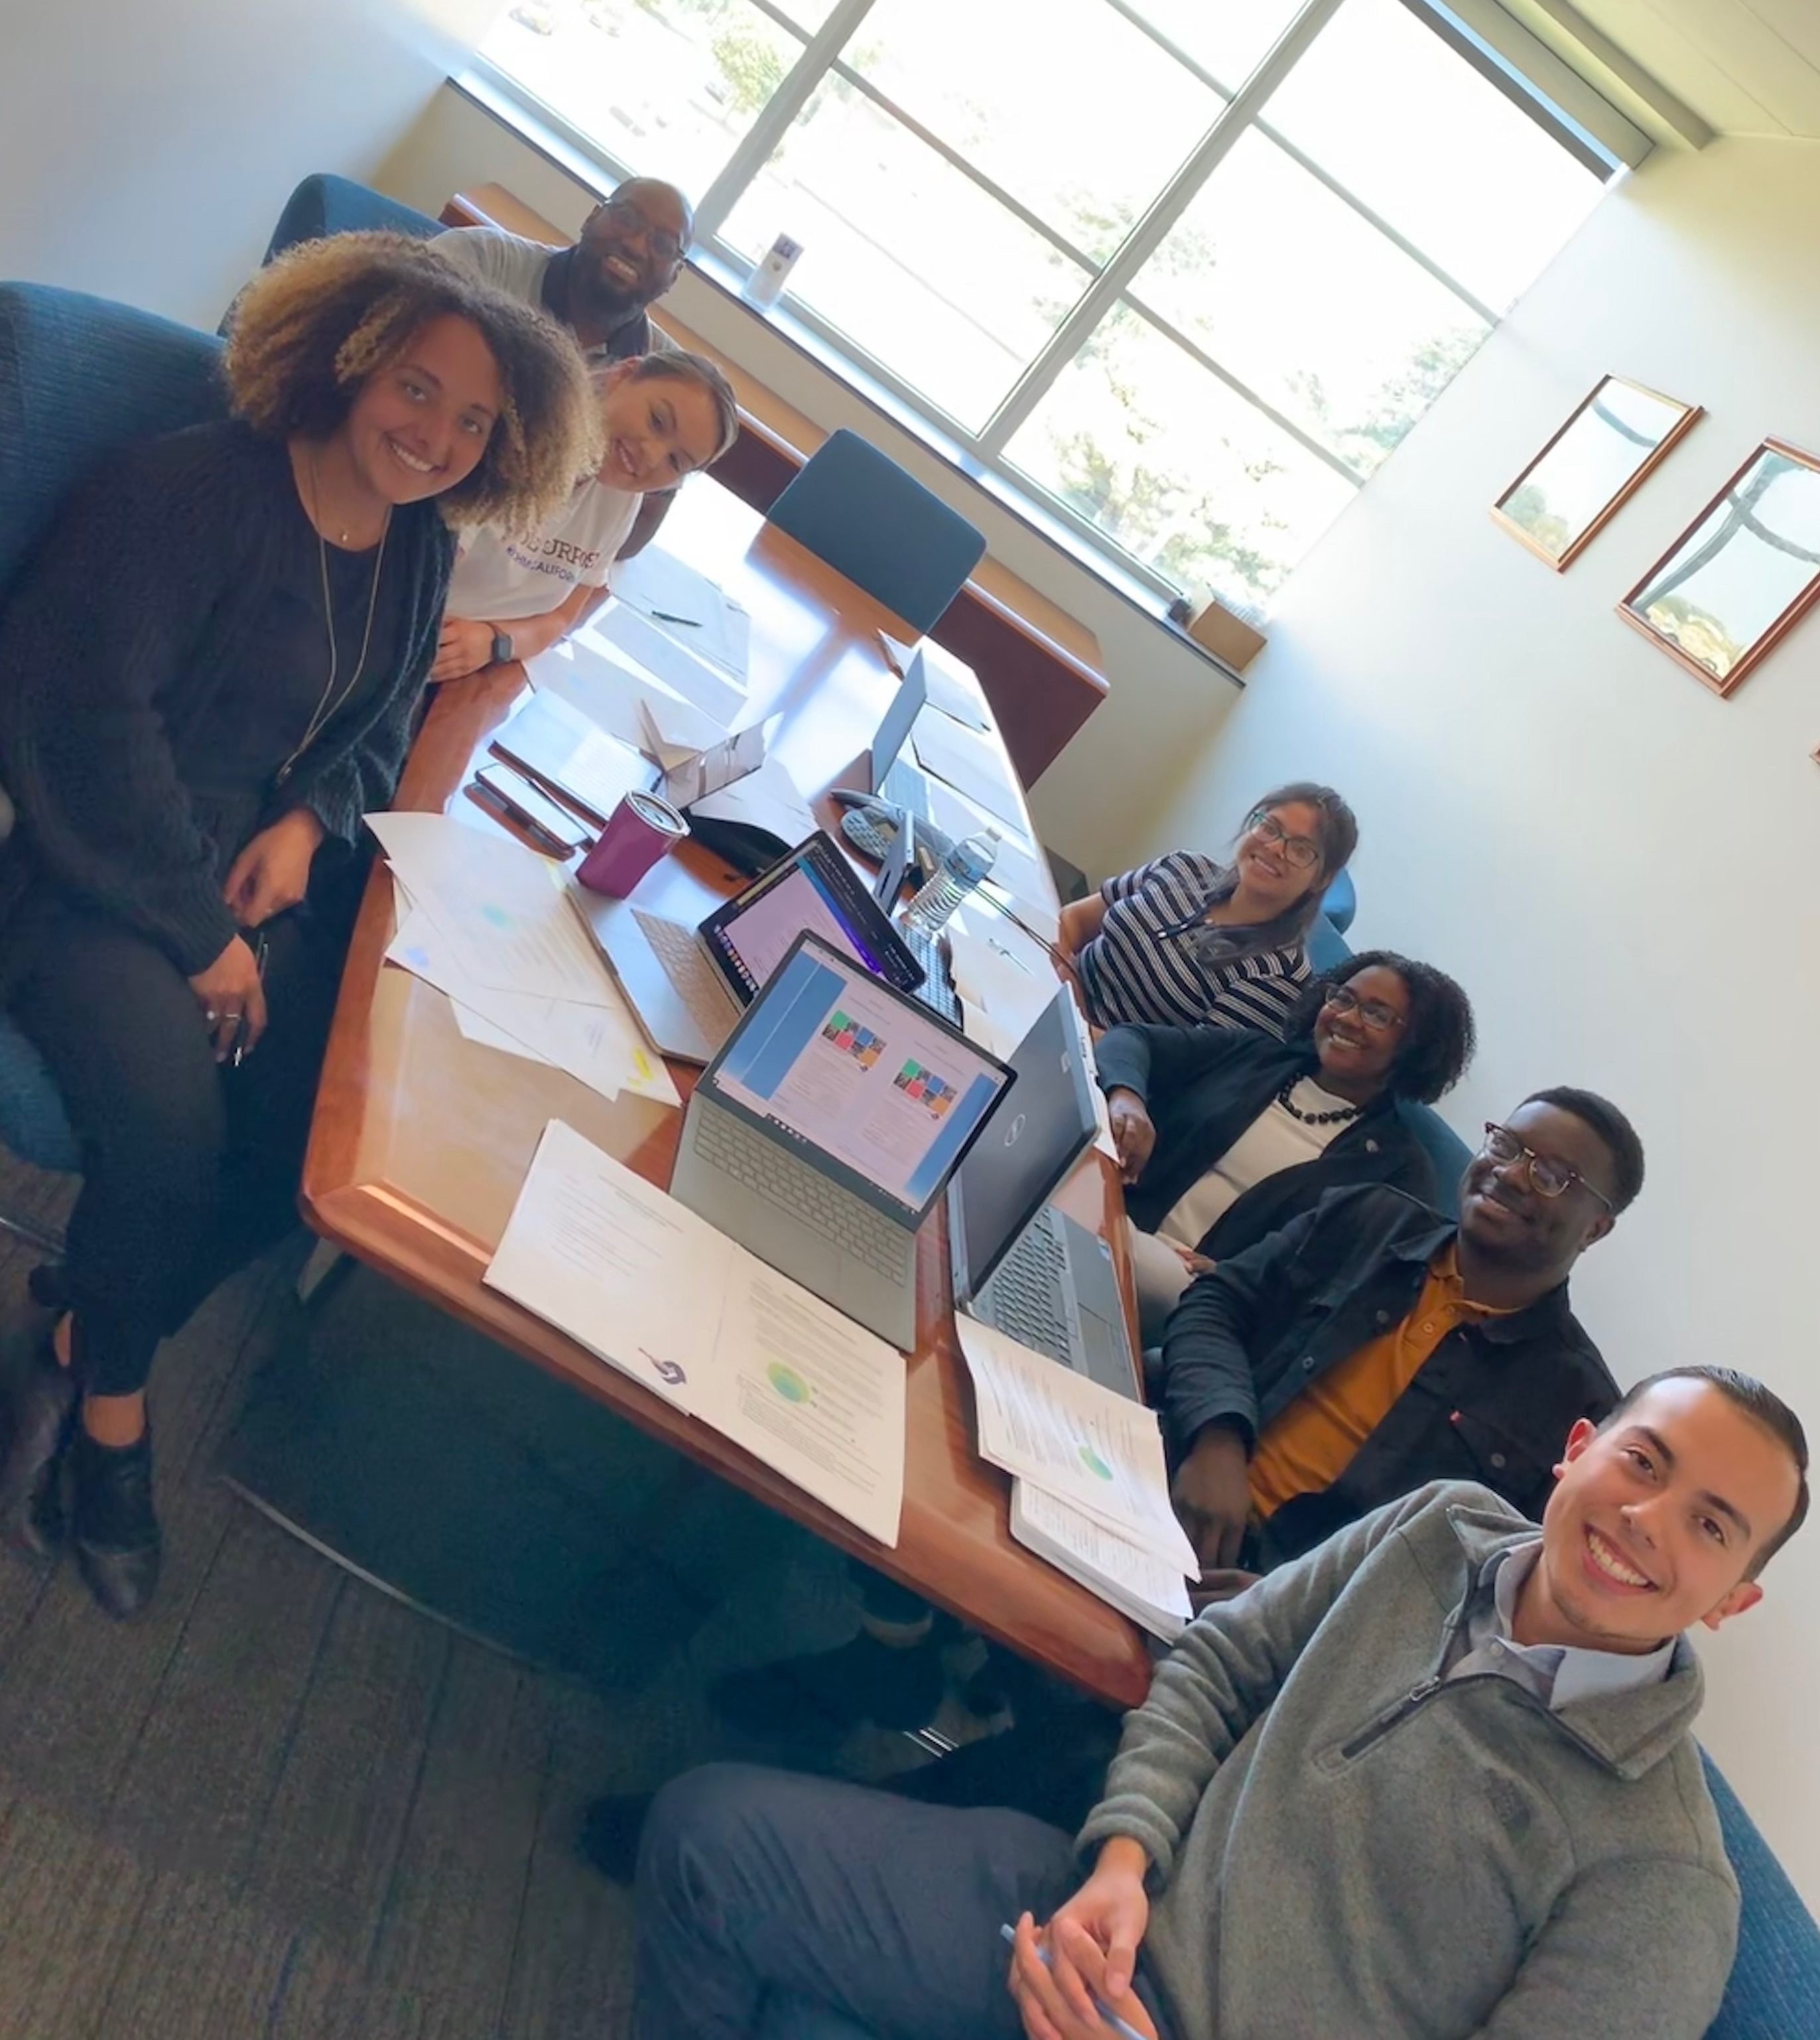


Contact Information
LaShonda White, Director
LaShonda_White@ci.richmond.ca.us
(510) 620-6828
Nicholas Delgado
Nicholas_delgado@ci.richmond.ca.us
(510) 620-5506
Kaitlen Burnom
Kaitlen_Brunom@ci.richmond.ca.us
Department Email
youth@ci.richmond.ca.us
510-620-6523
Patrick Seals, City Attorney's Office
Patrick_Seals@ci.richmond.ca.us
(510) 307-8016
Guadalupe Morales, Community Services
Guadalupe_Morales@ci.richmond.ca.us
(510) 620-6553
Abdul Black
Abdul_Black@ci.richmond.ca.us
/richmondcayouth
@richmondcayouth
Notes:
Contact Us:
youth@ci.richmond.ca.us
(510) 620-6523
LaShonda White, Director
LaShonda_White@ci.richmond.ca.us
David Padilla, Management Analyst
David_Padilla@ci.richmond.ca.us
Social Media
Facebook /richmondcayouth
Instagram @richmondcayouth

Slide 64
Oversight Board Appointments
Councilmember | Original Appt. | Seat No. | Youth Appointment | Seat No. | Youth Appt | Seat No. | Adult Appointment
Mayor (Eduardo Martinez) |  | 1 | Khalieghya Dandie-Evans | 2 | Vacant | 3 | Carol Hegstrom
District 4 (Sohelia Bana) | Tom Butt | 4* | Vacant |  |  | 5* | Vacant
District 2 (Cesar Zepeda) | Nat Bates | 6* | Vacant |  |  | 7* | Madiha Qader
District 6 (Claudia Jimenez) | Jael Myrick | 8 | Vacant |  |  | 9 | Teyona Galloway
District 5 (Sue Wilson) | Ben Choi | 10* | Vacant |  |  | 11* | Stephanie Sequeira
District 3 (Doria Robinson) | Demnlus Johnson | 12 | Vacant |  |  | 13 | Vacant
District 1 (Jamelia Brown) | Melvin Willis | 14 | Vacant |  |  | 15 | Guadalupe Enllana

