Slide 1

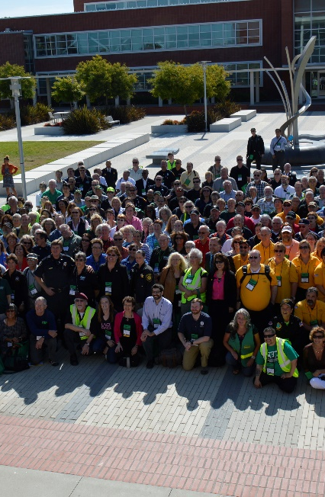

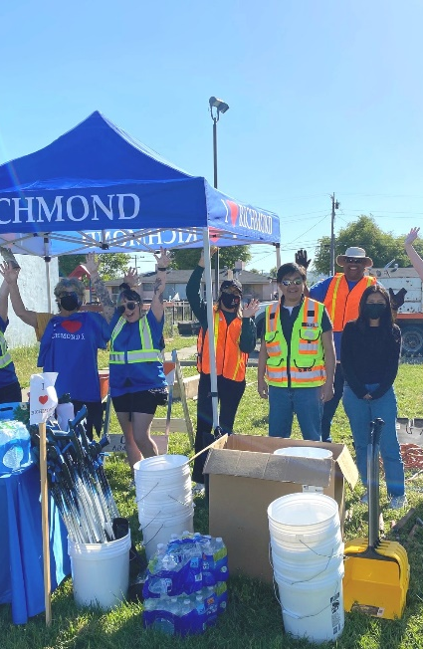

HUMAN RESOURCES DEPARTMENT
City Councilmember
Orientation
2025

Slide 2
AGENDA
Human Resources 2024 Activities in Review
Creating Employee Accountability
Human Resources Goals
Negotiations Process Overview
Risk Management Overview
Worker's Compensation Program
Claims Process
General Liability Program
Claims Process
Closing
Questions
Notes:
Sharrone

Slide 3
2024 Human Resources Activity In Review
Human Resources conducted 71 recruitments.
Human Resources reviewed 6,437 applications.
The City hired 111 employees and promoted 65 employees.
Notes:
Sharrone

Slide 4
Creating Employee Accountability
SPECIALIZED TRAINING
NEW SOFTWARE AND IMPROVED EFFICIENCIES
COMPREHENSIVE DEPARTMENTAL SUPPORT
PROMOTION OF THE CITY'S VISION AND MISSION
TRANSPARENCY AND INFORMATION
LABOR RELATIONS TRAINING
Notes:
Sharrone
Human Resources provides specialized trainings to reinforce the City’s expectations in regards to customer service, safety, skills, employee conduct, and compliance
Human Resources is implementing new software to streamline the employee evaluation process to encourage consistent and meaningful feedback on a regular basis.
Human Resources conducted a series of trainings designed to train managers on the progressive discipline process and active performance management methods to ensure that employees are well informed on expectations
Our Personnel Analysts are trained to be first point of contact for the department heads when they have personnel issues. The Personnel Analysts provide counseling, support, and guidance to ensure compliance with the Progressive Discipline model, Memorandum of Understandings and Labor Laws
Human Resources is prepared to lead the City’s efforts in maintaining a diverse workforce that is respectful of our differences and actively supports each other in accomplishing the City’s mission.
Human Resources believes in having an informed workforce. We work to accomplish that by being transparent and keeping employees abreast of policies and protocol through various avenues such as our monthly newsletter and periodic informative communique

Slide 5
Human Resources Goals
Strategic Goal 5. Strengthen the City’s internal infrastructure and processes
Ensure a seamless transition for new hires and departing employees by automating processes through software.
Successfully negotiate Memoranda of Understanding (MOUs) with eight bargaining units.
Continue developing a training and mentorship program to ensure the City’s workforce is well trained and competitive with the market.
Ensure mandatory trainings, important policies, and relevant written communications are translated into Spanish.
Notes:
Sharrone
Strengthen diversity, equity, and inclusion efforts to create a more inclusive and equitable workplace environment for all employees
Optimize hiring, onboarding, and offboarding practices to heighten the recruitment process and ensure a seamless transition for new hires and departing employees through employee training and automated processes.

Slide 6
City Council's Role in Negotiations
Sets Negotiation Parameters
Monitors Fiscal Impact
Represents Public Interest
May Face Public Input
Hears Updates from Staff
Provides Strategic Direction
Maintains Confidentiality
Approves Labor Agreements
Notes:
Sharrone
Sets Negotiation Parameters: Approves overall bargaining goals and parameters, often based on recommendations from city management or HR.
Approves Labor Agreements: Final authority to ratify or reject negotiated agreements (MOUs) between the city and employee unions.
Monitors Fiscal Impact: Ensures negotiated contracts align with the city’s budget and long-term financial sustainability.
Represents Public Interest: Balances the needs of employees with the interests of taxpayers and city service levels.
Hears Updates from Staff: Receives closed-session briefings and updates from negotiation teams during bargaining processes.
Provides Strategic Direction: May set broad policy objectives to guide negotiations, such as priorities for pay equity, recruitment/retention, or pension reform.
Maintains Confidentiality: Engages in confidential closed-session discussions under state labor laws (e.g., California’s Brown Act).
May Face Public Input: Often hears from unions and community members during public comment sessions, especially if negotiations are contentious.

Slide 7
City of Richmond Risk Management Program Overview Workers’ Compensation & General Liability Programs
Notes:
Sharrone

Slide 8
Workers’ Compensation
8
WHAT IS A WORK-RELATED ACCIDENT, INJURY, OR ILLNESS ?
An accident, injury, or illness that occurs while someone is doing something on behalf of or for the benefit of the employer.
The accident, injury, or illness arising out of employment and occurring during or in the course of employment (AOE/COE).
Notes:
Sharrone

Slide 9
The Worker’s Compensation Claim Process
9
Employee reports injury and wants treatment - Claim form (DWC-1) is given.
Claim is set-up – Claims examiner contacts injured worker to guide them through the process.
Claim is investigated - a determination to accept or deny must be made within 90 days (there are some exceptions that shorten this time frame).
If a claim is delayed by investigation, the injured worker can still receive medical treatment up to the first $10,000.
Once claim is accepted, the injured worker is entitled to medical treatment, lost wages, and a possible permanent disability award. This is all determined by the physician’s reports.
Claim settlement may include: future medical for life and a permanent disability award. Sometimes a compromise and release settlement is agreed upon to buy out all items listed and reduce the City’s future liability.
Notes:
Sharrone

Slide 10
General Liability
10
A general liability claim is filed when a citizen believes their personal property or personal injury was due to the City or an employee of the City.
Filing a claim gives the agency the opportunity to settle the claim before a lawsuit is filed and to investigate the claim so that it can properly defend itself, or to correct the conditions or practices that led to the claim.
Government entities are liable only if there is a statutory basis for the liability. Government entities are also protected by a variety of immunities from lawsuits.
Notes:
Sharrone

Slide 11
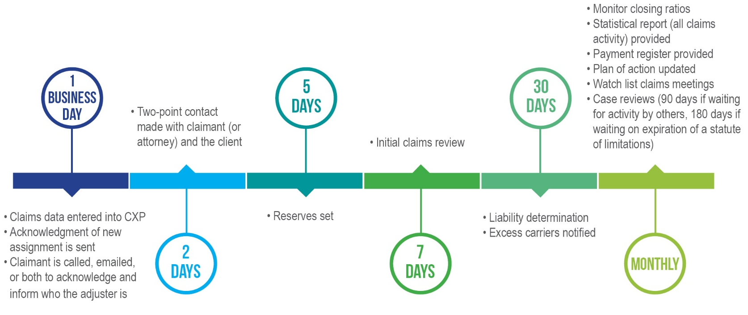
General Liability Claims Process
11
Notes:
Sharrone

Slide 12
YOUR HUMAN RESOURCES HEROES
We represent over 125 years of City of Richmond Experience!
Your Human Resources Team has employed several strategies focused on employee recruitment, retention, accountability and we have clear goals to improve employee morale and wellness, promote stability, employee retention, provide training and workforce development, succession planning, and more.
Notes:
Sharrone

Slide 13

Notes:
Sharrone

Slide 14

QUESTIONS?
Notes:
Sharrone

