Slide 1
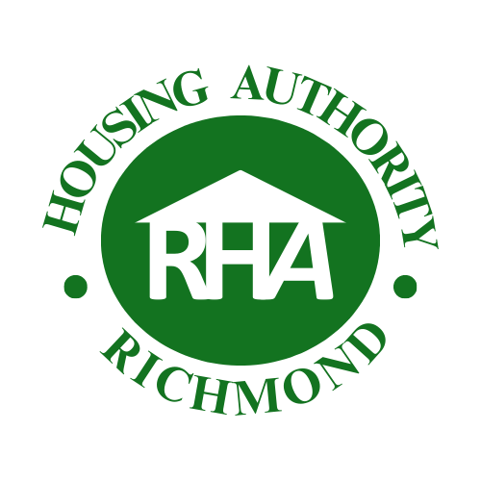

1
New Councilmember Orientation
Richmond Housing Authority (RHA) / 2019 Public Housing Authority Recovery and
Sustainability (PHARS)
Tuesday, May 6, 2025
Nannette J. Beacham, Economic Development Director
Antoinette Terrell, RHA Executive Director, (510) 620-6784
Gabino Arredondo, Project Manager
Notes:
Antoinette/Nannette
1

Slide 2
RHA Mission & Purpose
Provide affordable housing for Richmond's low- and very low-income residents through federally funded programs.
Administer and manage Public Housing for Nystrom Village, including income and household composition reporting, lease enforcement, maintenance, vacancy turnaround, and property management.
Manage RHA-affiliated entities and agreements that support additional affordable housing units in the City of Richmond (RHA Housing Corporation – Triangle Court, Friendship Manor; Easter Hill Housing Corporation – Richmond Village; Hacienda Heights; Nevin Plaza).
Notes:
Antoinette/Nannette
Provide affordable housing for Richmond's low- and very low-income residents through federally funded programs.
Administer and manage Public Housing for Nystrom Village, including income and household composition reporting, lease enforcement, maintenance, vacancy turnaround, and property management.
Manage RHA-affiliated entities and agreements that support additional affordable housing units in the City of Richmond (RHA Housing Corporation – Triangle Court, Friendship Manor; Easter Hill Housing Corporation – Richmond Village; Hacienda Heights; Nevin Plaza).
2

Slide 3
Brief History of RHA
Established in 1941, RHA was created to address the need for affordable housing during WWII.
Post-war, RHA continued to manage and develop housing projects.
Examples include Nevin Plaza, Hacienda Heights, Friendship Village,Triangle Court, Richmond Village and Nystrom Village.
During the 2010s, RHA encountered substantial operational and financial challenges attributed to several factors, including financial mismanagement, deferred maintenance, inadequate record-keeping, and a lack of adherence to HUD policies.
Notes:
Antoinette/Nannette
During the war, Richmond experienced a massive population increase due to an influx of workers for the Kaiser shipyards. To house these workers, the federal government and Richmond, constructed numerous housing projects.
Established in 1941, RHA was created to address the need for affordable housing during WWII.
Post-war, RHA continued to manage and develop housing projects.
Examples include Nevin Plaza, Hacienda Heights, Triangle Court, and Nystrom Village.
During the 2010s, RHA encountered substantial operational and financial challenges attributed to several factors, including financial mismanagement, deferred maintenance, inadequate record-keeping, and a lack of adherence to HUD policies.
3

Slide 4
Background
RHA is currently classified as a “troubled” Housing Authority and has been operating under a Public Housing Authority Recovery and Sustainability (PHARS) Agreement since February 5, 2013.
RHA continues to follow the guidelines set forth in the 2019 PHARS Agreement and respond to the Notice of Substantial Default.
The performance metrics outlined in the 2019 PHARS are specifically aimed at enhancing RHA’s financial health, boosting the ratings of its housing programs, and ensuring long-term sustainability.
Notes:
Antoinette/Nannette
RHA is currently classified as a “troubled” Housing Authority and has been operating under a Public Housing Authority Recovery and Sustainability (PHARS) Agreement since February 5, 2013.
As of now, RHA continues to follow the guidelines set forth in the 2019 PHARS Agreement.
The performance metrics outlined in the 2019 PHARS are specifically aimed at enhancing RHA’s financial health, boosting the ratings of its housing programs, and ensuring long-term sustainability.
4

Slide 5
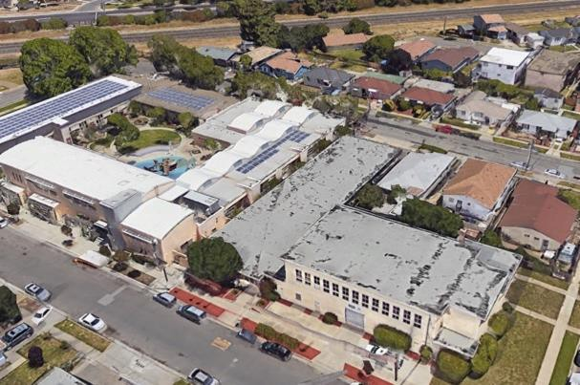
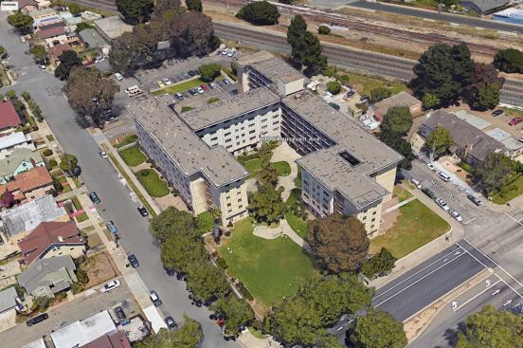
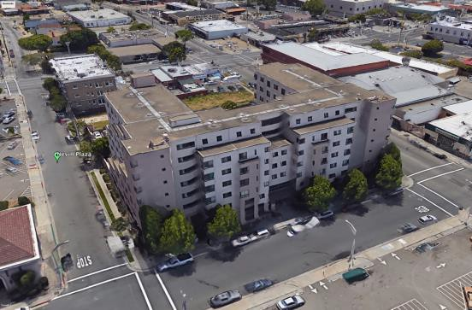
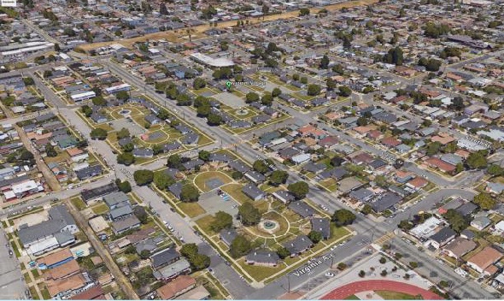
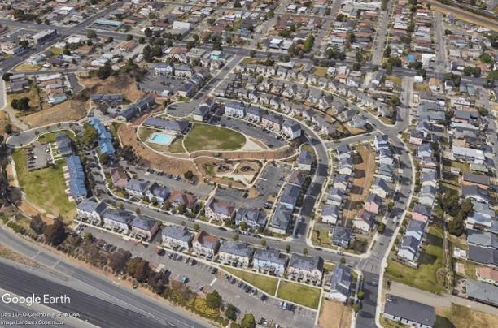
Components PHARS of Agreement
Transfer the Section 8 HCV program to the Housing Authority of Contra Costa County.
Reposition our Public Housing Properties:
Administrative Building
Hacienda
Nevin Plaza
Nystrom
Richmond Village
Complete and submit Financial Audits
Administrative Building
Hacienda
Nevin Plaza
Nystrom Plaza
Richmond Village 1, 2 and 3
Notes:
Antoinette/Nannette
5

Slide 6
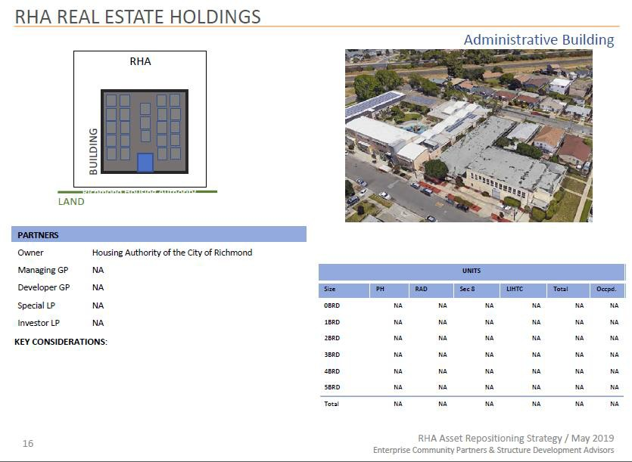
6
Notes:
Antoinette/Nannette
The address for the old administrative building is 360 South 27th St., which is now used by Richmond Builds.
6

Slide 7
Administration Building
5
Task # | Task | Status
2.1 | Submission of disposition application to SAC | Complete
2.2 | SAC acceptance of a complete Section 18 PIC application | Complete
2.3 | Submit Financing Plan to San Francisco Regional Office (SFRO) and submit Financing Applications to TCAC/HCD | Complete
Update: Property disposition approved by HUD and transferred to the City of Richmond for the Richmond Build Program in 2022
Notes:
Antoinette/Nannette
Property Transferred to the City of Richmond through the Section 18 disposition process.
7

Slide 8
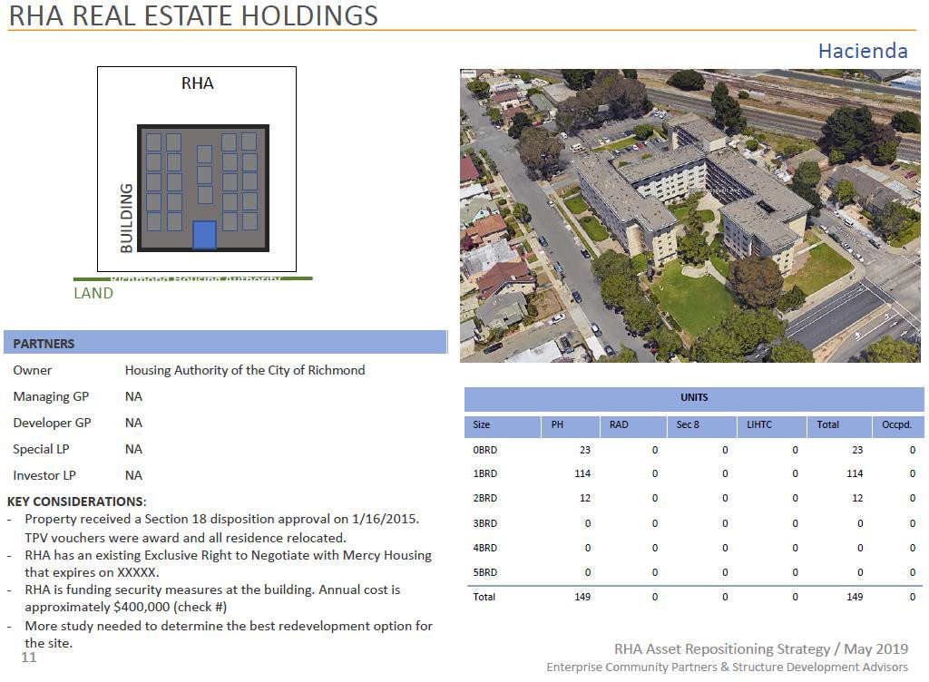
4
Notes:
Antoinette/Nannette/Gabino
8

Slide 9
Hacienda
Task # | Task | Status
1.1 | Finalize Financial Terms between RHA and Mercy | Complete
1.2 | Request Revised Disposition Application from the Special Applications Center (SAC) | Complete
1.3 | Submit Financing Plan to SFRO and submit Financing 3/1/2020 Applications to The California Tax Credit Allocation Committee (TCAC)/California Department of Housing and Community Development (HCD) | Complete
1.4 | Conveyance / Closing of Hacienda | Complete
1.5 | SAC acceptance of a complete Section 18 PIC disposition application for Hacienda Remainder Parcel | Not Started
RHA's efforts to engage a broker for the vacant parcel were unsuccessful. The Hacienda remaining parcel is now entirely under the management of the RHA, which was previously utilized as a staging area during construction of the new Hacienda development. Currently, the RHA is concentrating on securing a development partner to revitalize Nystrom Village, considering the units' deteriorating state
Notes:
Antoinette/Nannette
RHA's efforts to engage a broker for property marketing were unsuccessful. The Hacienda Remaining Parcel is now entirely under the management of the RHA, which had previously utilized it as a staging area during construction. Currently, the RHA is concentrating on securing a development partner to rejuvenate Nystrom Village, considering the units' deteriorating state. This focus is driving the upcoming Request for Proposals (RFP), expected to be issued in August 2025, after which the Section 18 Disposition process will commence.
9

Slide 10
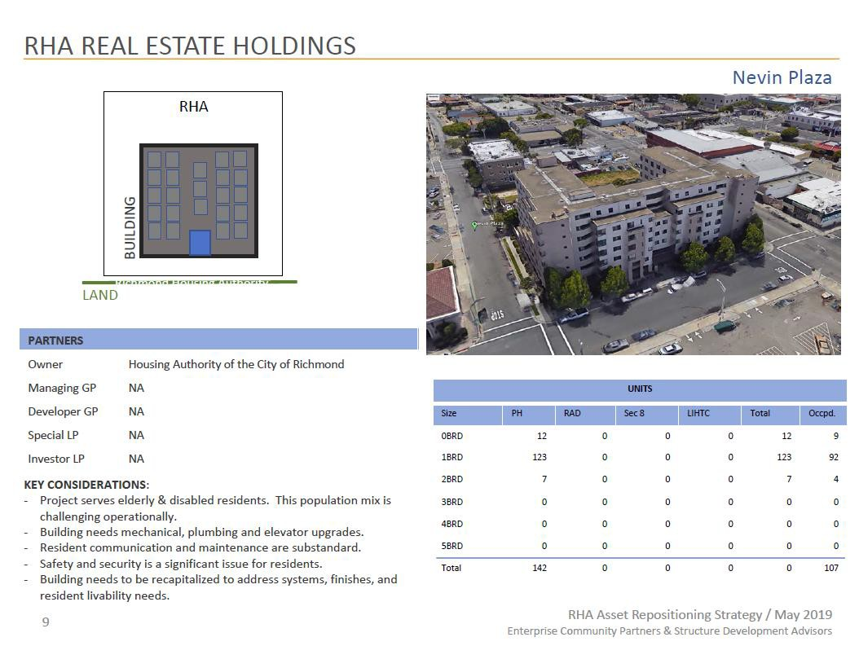
8
Notes:
Antoinette/Nannette
10

Slide 11
Nevin Plaza Phase I
7
Task # | Task | Status
3.1 | Issue RFP for Development Partner w/ elevator addendum | Complete
3.2 | Select a Development Partner | Complete
3.3 | Special Applications Center (SAC) acceptance of a complete Section 18 Public Housing Information Center (PIC) application | Complete
3.4 | Submit Financing Plan to SFRO and submit Financing Applications to TCAC/HCD | Complete
3.5 | Closing /Conveyance /Start Construction | Complete
Update: EAH Housing was selected as the development partner to redevelop Nevin Plaza. During the development process, a subdivision created a small tract of land that is still owned by RHA and is subject to a HUD Declaration of Trust. Phase 2 will involve new construction on the land located behind the existing Nevin Plaza. Phase 1 of Nevin Plaza has a projected completion date in June 2025, pending the finishing touches on the common areas.
Notes:
Antoinette/Nannette
EAH was selected as the development partner to redevelop Nevin Plaza.
During the development process, a subdivision created a small tract of land that is still owned by RHA and is subject to a HUD Declaration of Trust.
Phase 2 will involve new construction on the land located behind the existing Nevin Plaza. Phase 1 of Nevin Plaza has a projected completion date in June 2025, pending the finishing touches on the common areas.
11

Slide 12
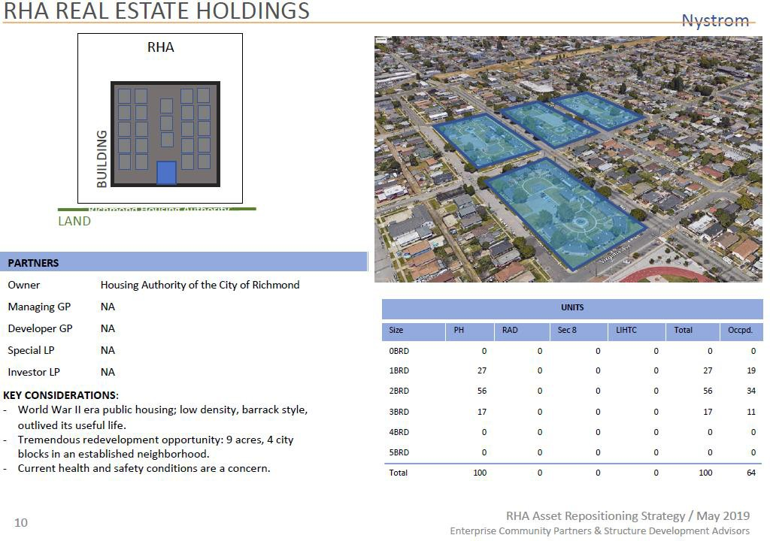
10
Notes:
Antoinette/Nannette
12

Slide 13
Nystrom Village
9
Task # | Task | Status
4.1 | Issue RFQ for Master Plan | Complete
4.2 | Finalize terms between RHA and Developer | Not Started
Update: The Richmond Housing Authority (RHA) faced challenges finalizing a Disposition and Development Agreement with McCormack Baron Salazar (MBS) and Richmond Neighborhood Housing Services (RHNS) before the Exclusive Right to Negotiate Agreement (ERNA) expired on October 31, 2023. After no agreement was reached, a new Request for Qualifications (RFQ) process was initiated. The first phase of the project will be to replace existing public housing at Nystrom Village
4.3 | SAC acceptance of a complete Section 18 PIC application | May/June 2025
4.4 | Closing /Conveyance /Start Construction | Not Started
Notes:
Antoinette/Nannette
The Richmond Housing Authority (RHA) faced challenges in finalizing a development agreement with McCormick Baron Salazar (MBS) and Richmond Neighborhood Housing Services (RHNS) before the deadline, leading to an extension of the Exclusive Right to Negotiate Agreement (ERNA) until October 31, 2023.
However, no agreement was finalized by that date. Following this, the new Request for Qualifications (RFQ) process for the redevelopment of Nystrom Village concluded, and on December 17, 2024, the RHA Board selected a developer to replace the existing public housing on-site and create new homeownership and/or rental housing opportunities on the rest of the land.
13

Slide 14
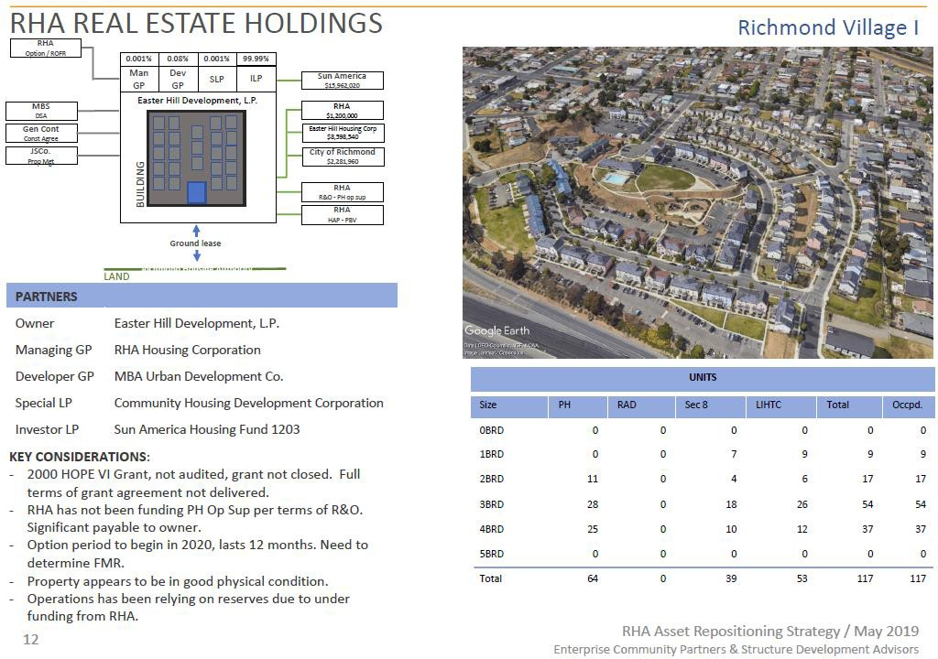
12
Notes:
Antoinette/Nannette
14

Slide 15
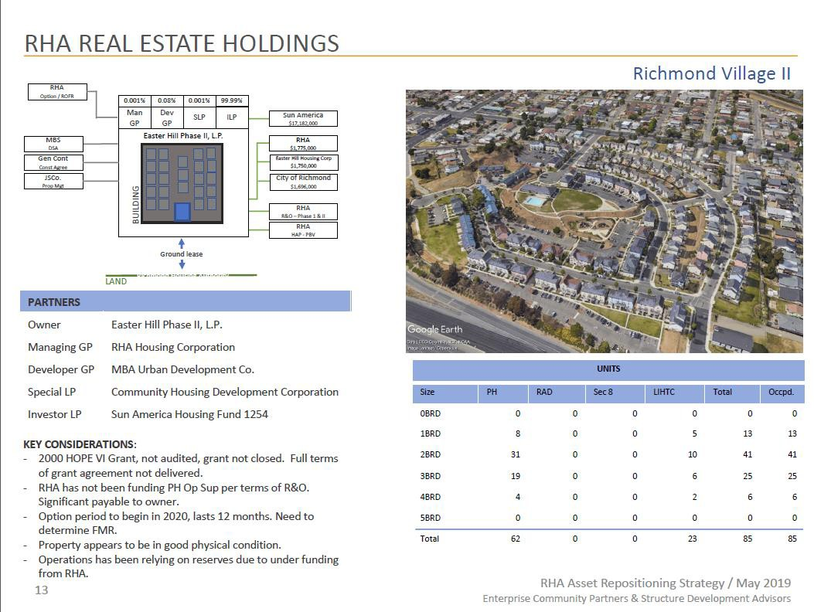
13
Notes:
Antoinette/Nannette
15

Slide 16
Richmond Village I and II
11
Task # | Task | Status
5.1 | Submit RAD Application | Complete
Update: Converting to Rental Assistance Demonstration (RAD) involves three tasks: 1) exit the investor limited partner - Complete. 2) negotiate new terms with McCormack Baron Salazar (MBS) for the future ownership and operations of Richmond Village - Complete 3) submit a RAD application – Complete
5.2 | Submit RAD Financing Plan | In Progress
Update: RHA and McCormack Baron Salazar are preparing the necessary documents to submit a RAD Financing Plan to HUD.
5.3 | Close RAD conversion | Not Started
Notes:
Antoinette/Nannette
RHA and McCormick Baron Salazar are preparing the necessary documents to submit a RAD Financing Plan to HUD.
16

Slide 17
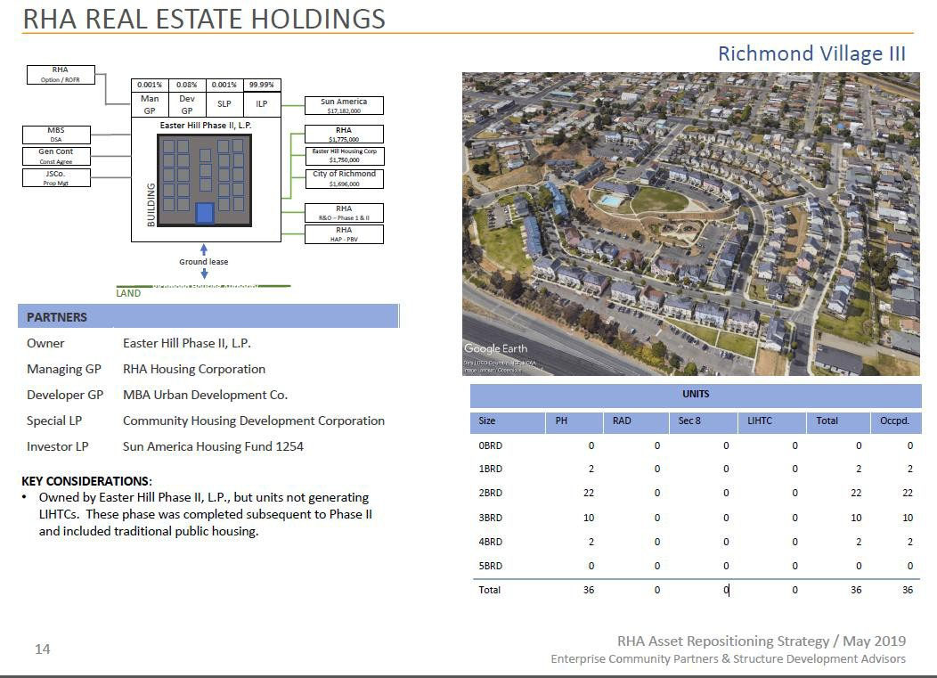
15
Notes:
Antoinette/Nannette
17

Slide 18
Richmond Village III
14
Task # | Task | Status
6.1 | SAC acceptance of a complete Section 18 PIC application | Not Applicable
6.2 | Receive Tenant Protection Vouchers | Not applicable
6.3 | Closing /Conveyance /Start Construction Update: This task no longer applies as closing will occur for Richmond Village I, II, and III simultaneously as part of a RAD/Section 18 small PHA Blend conversion. | Not applicable
Notes:
Antonette/Nannette
This task no longer applies as closing will occur for Richmond Village I, II, and III simultaneously as part of a RAD/Section 18 small PHA Blend conversion.
18

Slide 19
Audits
16
Task # | Task | Status
7.1 | Submit PH Organizational Chart of RHA staff; chart to include names, titles, and responsibilities and duties | Completed
7.2 | Complete HCV Close Out Audit | In Progress
Update: 2017 Audited Financial Statements were completed, issued, submitted to REAC and approved by HUD. 2018 Audited Financial Statements were completed, issued, submitted to REAC, and approved by HUD. 2019 Audited Financial Statements were completed, issued, submitted to REAC, and approved by HUD. RHA is awaiting HUD field office confirmation of the Housing Choice Voucher (HCV) Program closeout (Task# 7.2). 2020 Audited Financial Statements were completed and issued. Submission to REAC is in progress. 2021 financial data is in progress to be audited.
7.3 | Submit operating budgets for each AMP and Central Office Cost Center (COCC). | On-going
Notes:
Antoinette/Nannette
Update:
2017 Audited Financial Statements were completed, issued, submitted to REAC and approved by HUD.
2018 Audited Financial Statements were completed, issued, submitted to REAC, and approved by HUD.
2019 Audited Financial Statements were completed, issued, submitted to REAC, and approved by HUD. RHA is awaiting HUD field office confirmation of the Housing Choice Voucher (HCV) Program closeout (Task# 7.2).
2020 Audited Financial Statements were completed and issued. Submission to REAC is in progress.
2021 financial data is in progress to be audited.
19

Slide 20
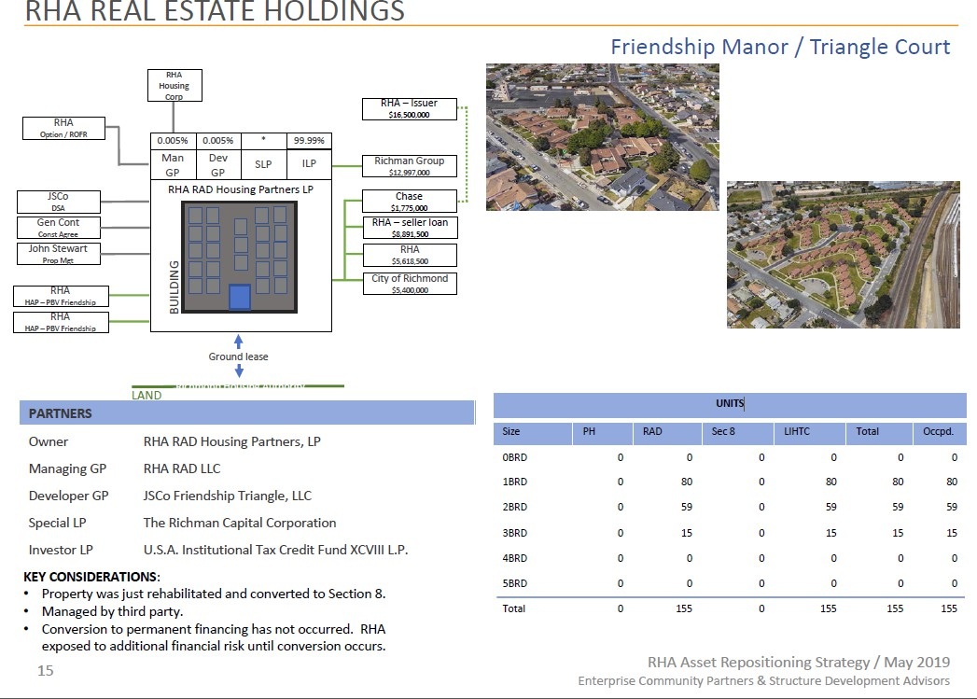
17
Notes:
Antoinette/Nannette
20

Slide 21
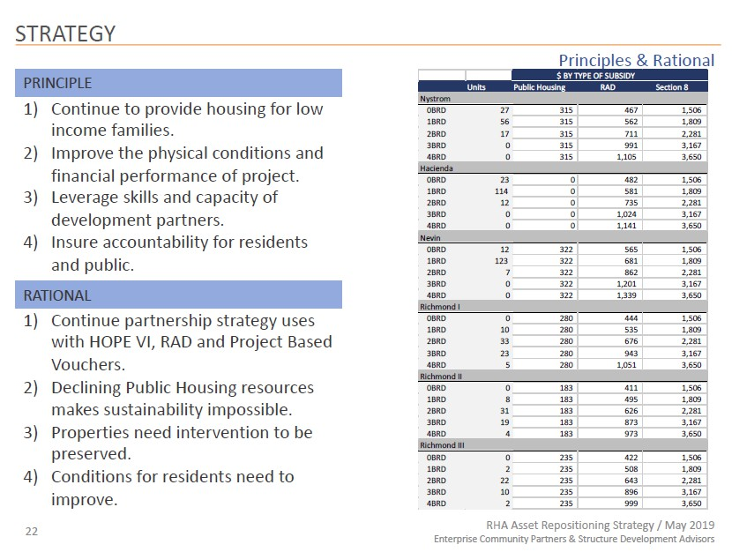
Notes:
Antoinette/Nannette
21

