Slide 1
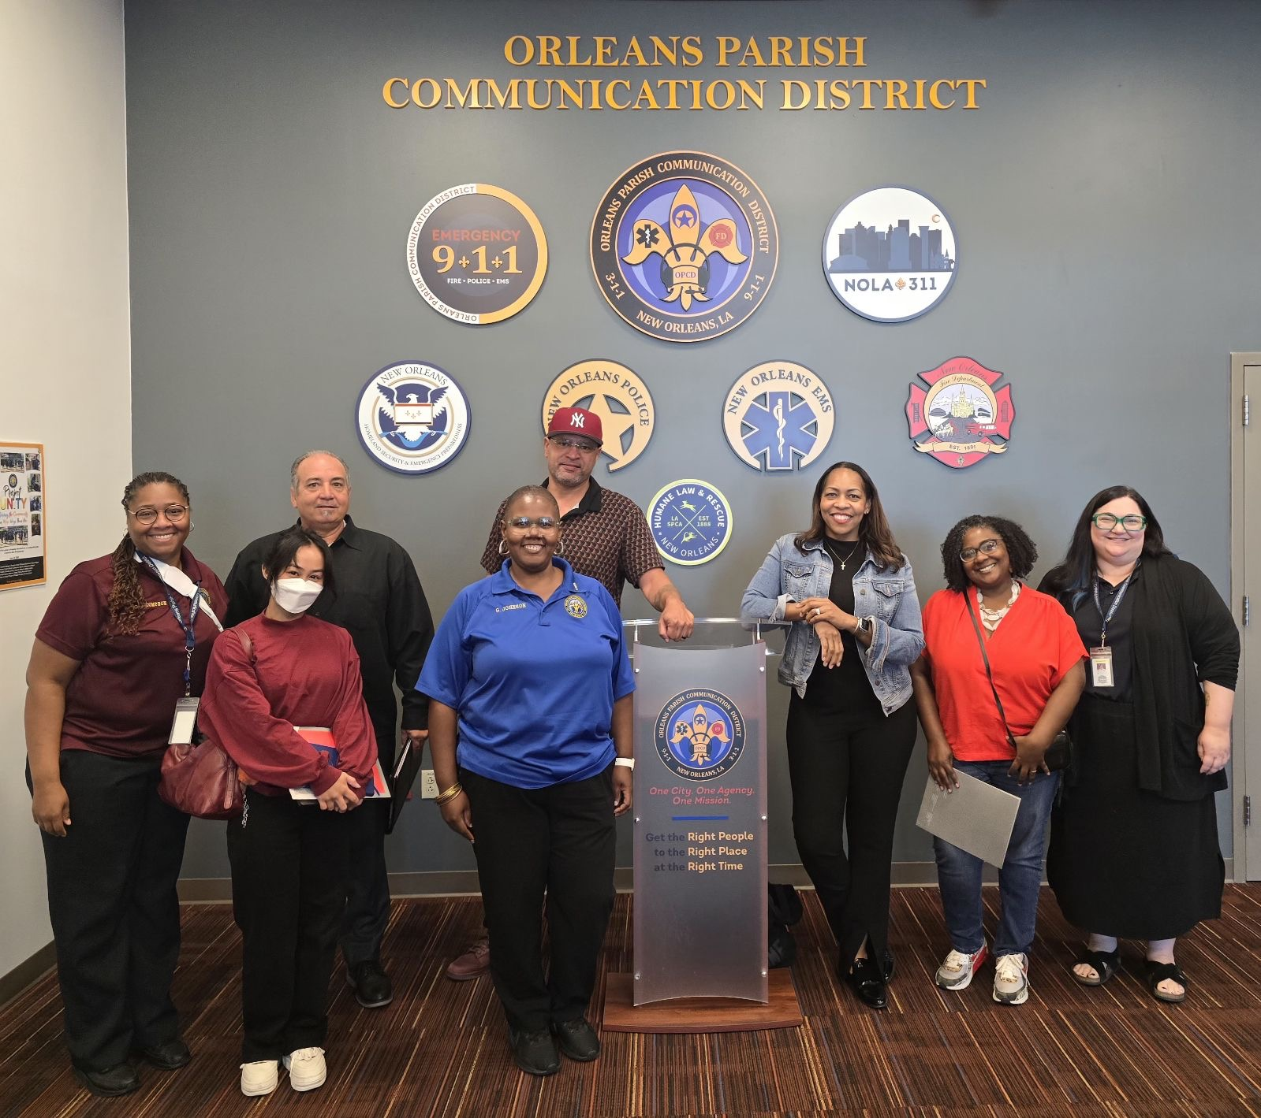

New Councilmember Orientation
COMMUNITY CRISIS RESPONSE PROGRAM
Sam Vaughn, Deputy Director
Michael Romero, Program Manager
May 27, 2025
Picture of CCRP Staff and RPD Chief Bisa French and City Deputy Manager LaShonda White visit New Orleans Parish Communication Center
R O C K
Reach Out with Compassion and Kindness

Slide 2
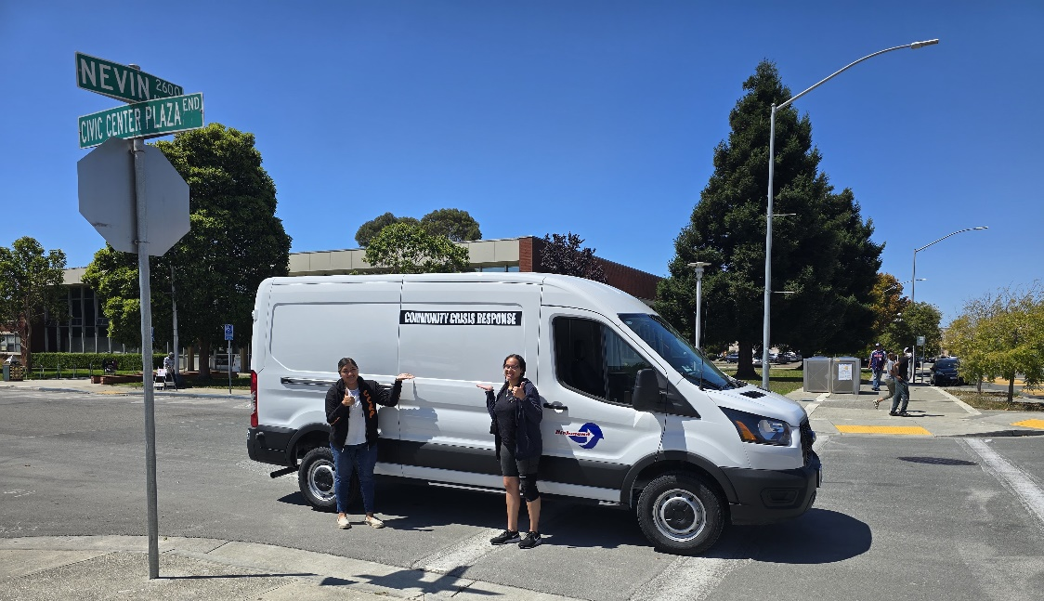
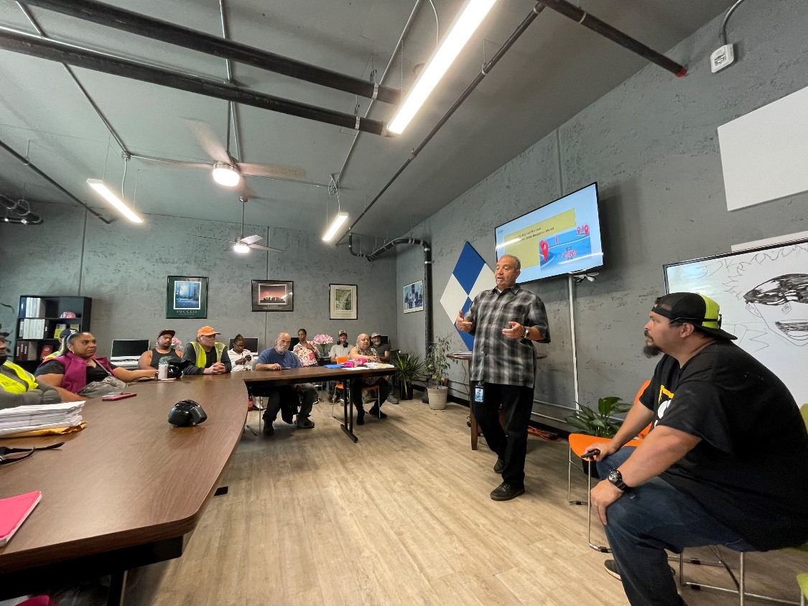
PROGRAM OVERVIEW
An alternative and supportive safety response system designed to address low acuity, non-medical, and non-violent situations using a trauma-informed, healing-centered, and community-based approach. CCRP responders, also known as ROCK responders, will be trained in de-escalation, mediation, and other crisis response tools to ensure the most appropriate and effective response for community members experiencing a crisis.
Goals:
Provide an appropriate and effective response to acute behavioral health situations
Reduce overreliance on law enforcement for non-emergency matters
Connect individuals in crisis with appropriate services and support
The calls that CCRP-ROCK will be responding to are:
Wellness Checks
Disturbance e.g. noise, hanging in front of businesses.
Transport
School discipline e.g. counselor calls
Low-level suicidal ideation—no immediate harm to oneself or others
Request for Information/Resources
Official CCRP Vans
Prior to van wrap and van buildout
CCRP Presentation to SOS
September 2024

Slide 3
YEAR OVERVIEW
FY 23-24 CCRP Program Manager hired
August 2024
Associate Admin Analyst hired
October 2025 Logo Contest Launched
FY24-25 (2) Vans Purchased for Mobile Crisis Response teams
April 2025 Community Intervention Specialist Jobs Posted
March 2024
Youth Logo Contest Winners Announced
January 2025
City Stakeholders Working group established
February 2025
Admin Student Intern Hired
October 2025 Official team name chosen by community - ROCK
October 2024
Visit to New Orleans Mobile Response Team
November 2024
Visit to Durham North Carolina
September 2024
National Institute for Criminal Justice Reform Contract Approved for Data Management Assistance
December 2024
Bonterra Apricot 360 Software Contract Approved
May/June 2025
CIS Interviews
JURISDICTIONS/PROGRAMS VISITED AND CONSULTED
Contra Costa County A3
Oakland MACRO
Long Beach Community Crisis Response Team
Antioch Angelo Quinto Community Response Team
Los Angeles Unarmed Crisis Response
Petaluma SAFE Project
Durham, North Carolina HEART
New Orleans Mobile Crisis Response Team
Portland Safety Response (Oregon)
Merced County Mobile Crisis Response Team
San Diego County Mobile Crisis Response Team
San Jose TRUST

Slide 4
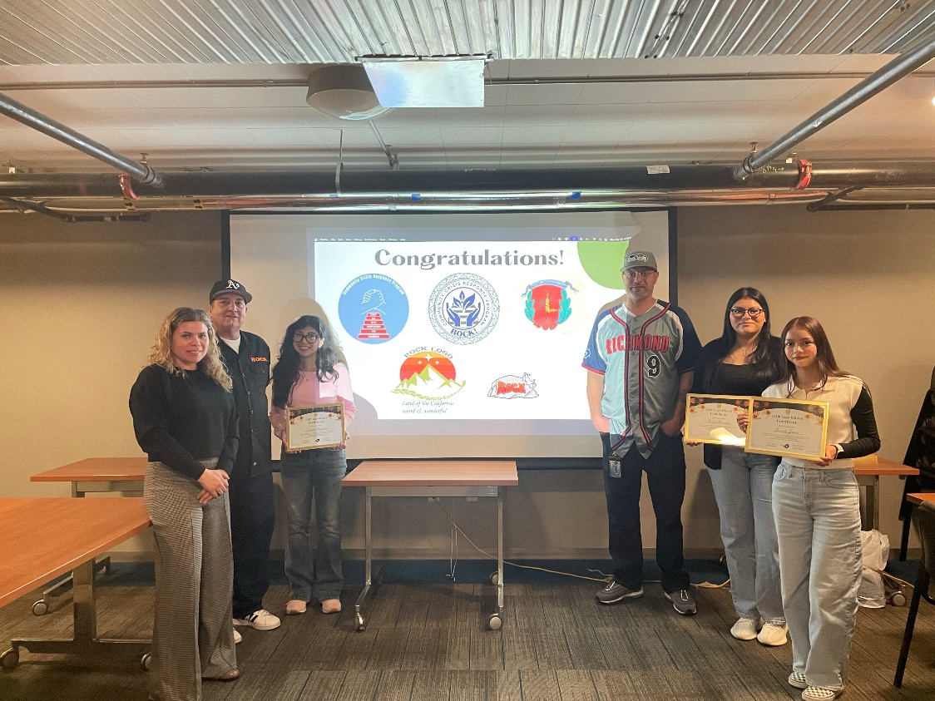
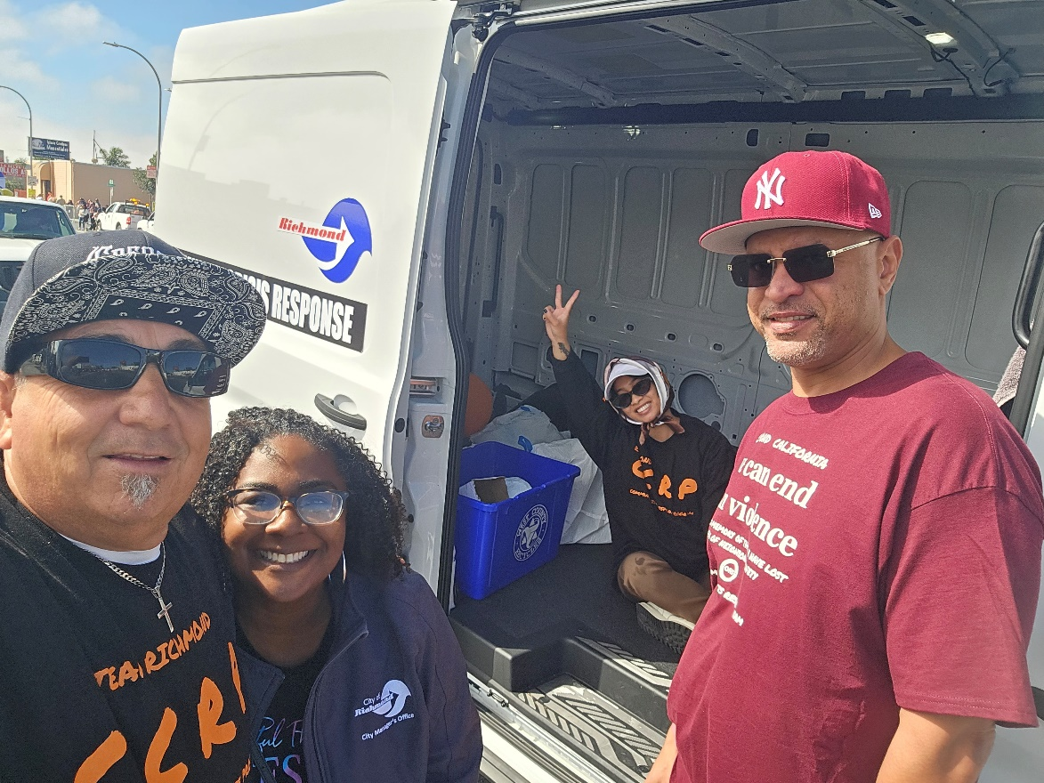
ACCOMPLISHMENTS IN FY24-25
Hired an Associate Administrative Analyst and an Administrative Student Intern
Used Microsoft Project and Harvard GPL Alternative Crisis Response Toolkit to list and map out necessary program components.
Met with other alternative response programs: Oakland (MACRO); Portland Street Response; New Orleans, Louisiana; and Durham, North Carolina to learn about their Crisis Response Programs to support ongoing development for CCRP-ROCK program
Completed Ride-alongs with Oakland MACRO and Durham HEART team
Community poll for official team name: ROCK – Reach Out with Compassion and Kindness
Youth Logo Contest held to create official CCRP-ROCK logo
Joined Community of Practice meetings from:
Harvard-Kennedy Government Performance Lab
4th Branch Institute FKA International Crisis Response Association
Dignity Best Practice
Met with the Medical Mobile Crisis Technical Assistance Center for a potential funding stream
Youth Logo Contest Winners
March 2025
CCRP Staff at Rescheduled Cinco De Mayo Parade September 2025

Slide 5







ACCOMPLISHMENTS (cont’d)
Continue relationship building with the Contra Costa County A3 program
Partnership with Vera Institute of Justice
Collaboration with NICJR and Slalom for Data Dashboard buildout and Data Visualization/Management to establish a comprehensive framework for collecting, analyzing, and interpreting data related to CCRP.
Continuous meetings with Richmond Dispatch to discuss Dispatch protocols and call types. Staff also participated in a “sit-a-long” at the Communications Center to observe 911 dispatch and to discuss the implementation of CCRP
Six (6) appointments made to the Community Advisory Board as of May 7, 2025
Established monthly internal working group with relevant City Personnel for feedback and suggestions on ongoing program development. Stakeholders include:
Richmond Dispatch
Richmond Police Department (RPD)
Richmond Police Officers’ Association
RPD Crime Prevention
Richmond Fire

Slide 6
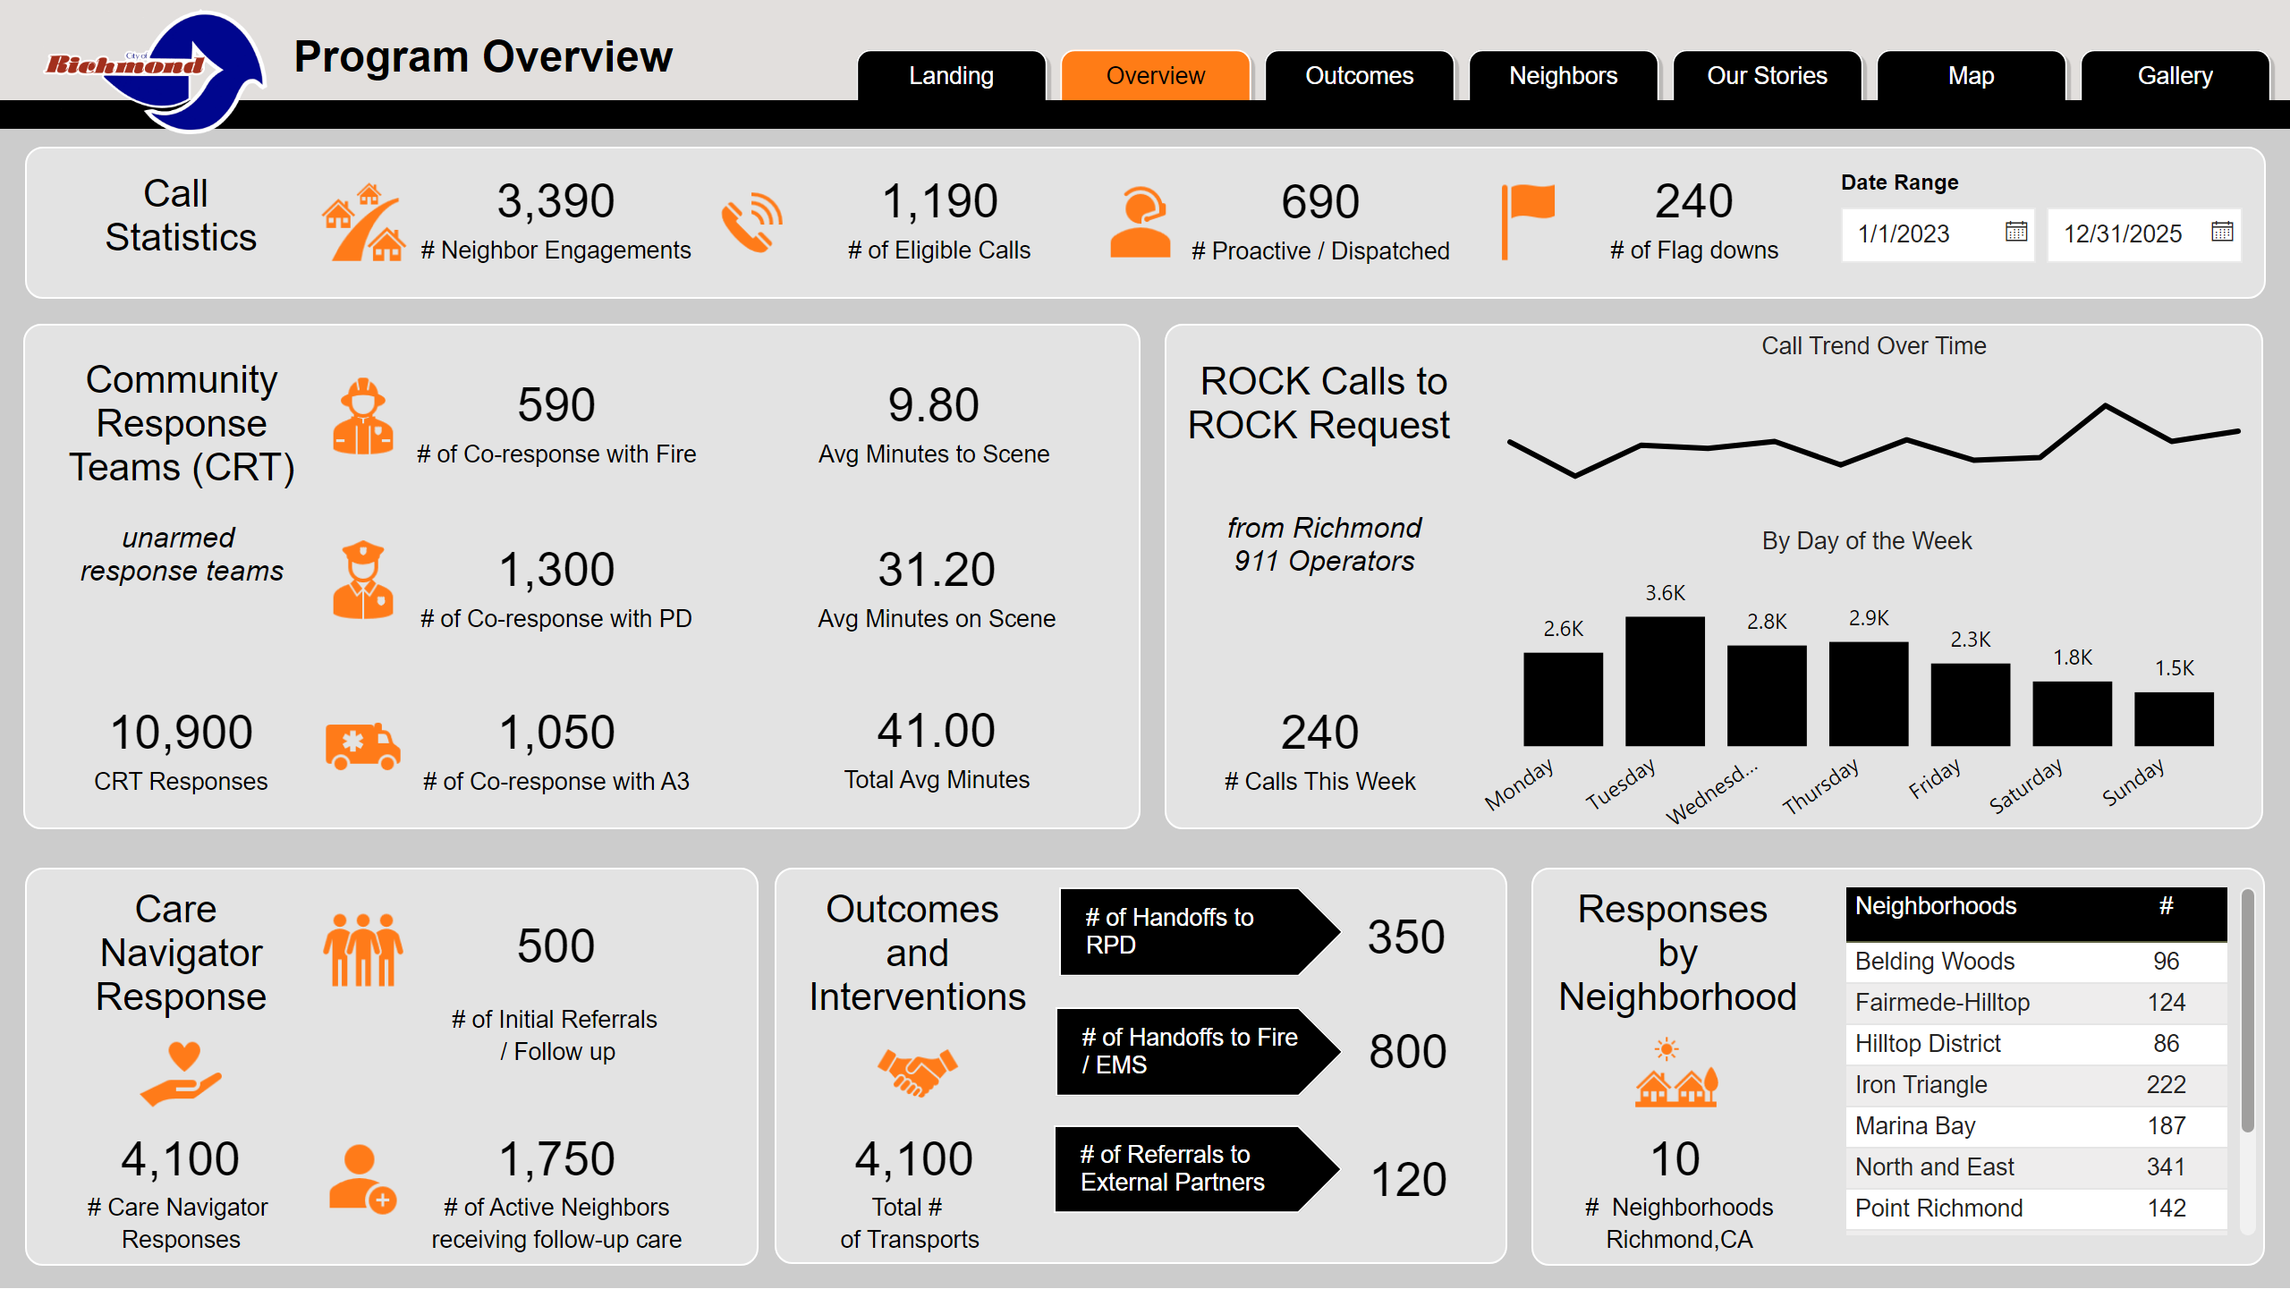
Overview
DATA DASHBOARD DRAFT*
*Numbers displayed are dummy data.
Notes:
Gold Bar
No alt text provided
pageNavigator
No alt text provided
Header Back
No alt text provided
image
No alt text provided
Cap Top
No alt text provided
textbox
No alt text provided
card
No alt text provided
card
No alt text provided
card
No alt text provided
card
No alt text provided
Cap Top
No alt text provided
textbox
No alt text provided
card
No alt text provided
Cap Top
No alt text provided
textbox
No alt text provided
Cap Top
No alt text provided
Date Range
No alt text provided
card
No alt text provided
card
No alt text provided
card
No alt text provided
card
No alt text provided
image
No alt text provided
image
No alt text provided
image
No alt text provided
textbox
No alt text provided
card
No alt text provided
image
No alt text provided
textbox
No alt text provided
image
No alt text provided
image
No alt text provided
image
No alt text provided
card
No alt text provided
card
No alt text provided
card
No alt text provided
image
No alt text provided
image
No alt text provided
Cap Top
No alt text provided
textbox
No alt text provided
image
No alt text provided
card
No alt text provided
tableEx
No alt text provided
card
No alt text provided
card
No alt text provided
textbox
No alt text provided
textbox
No alt text provided
textbox
No alt text provided
textbox
No alt text provided
ABC
No alt text provided
ABC
No alt text provided
ABC
No alt text provided
card
No alt text provided
card
No alt text provided
card
No alt text provided
textbox
No alt text provided
image
No alt text provided
image
No alt text provided
Cap Top
No alt text provided
textbox
No alt text provided
card
No alt text provided
By Day of the Week
No alt text provided
Call Trend Over Time
No alt text provided

Slide 7
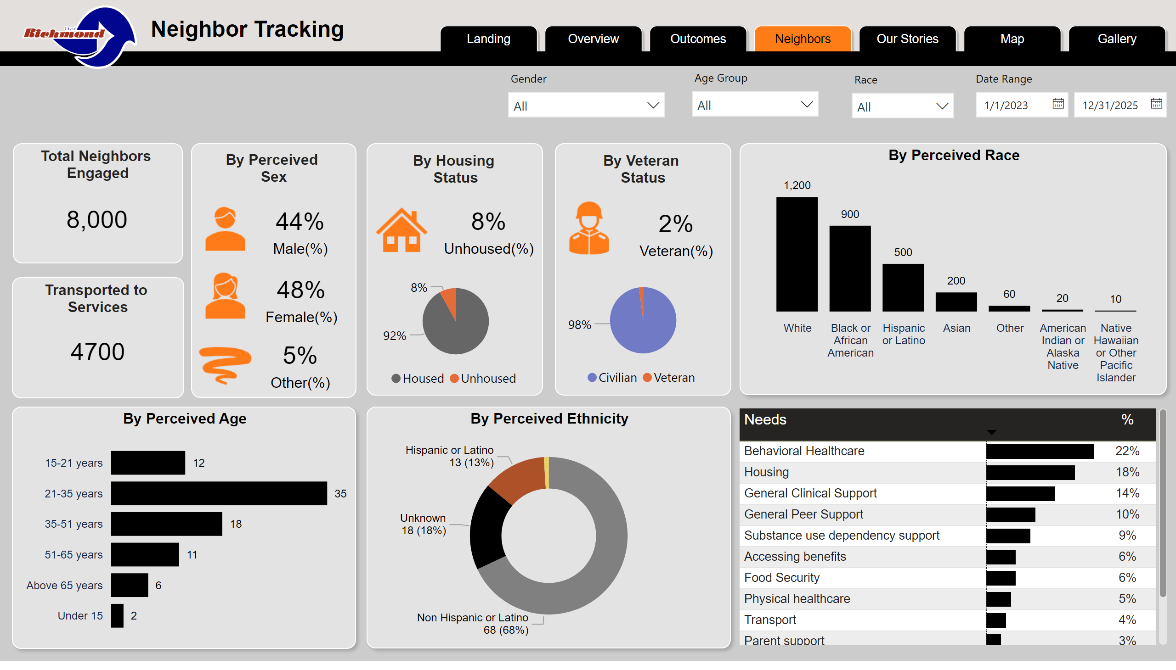
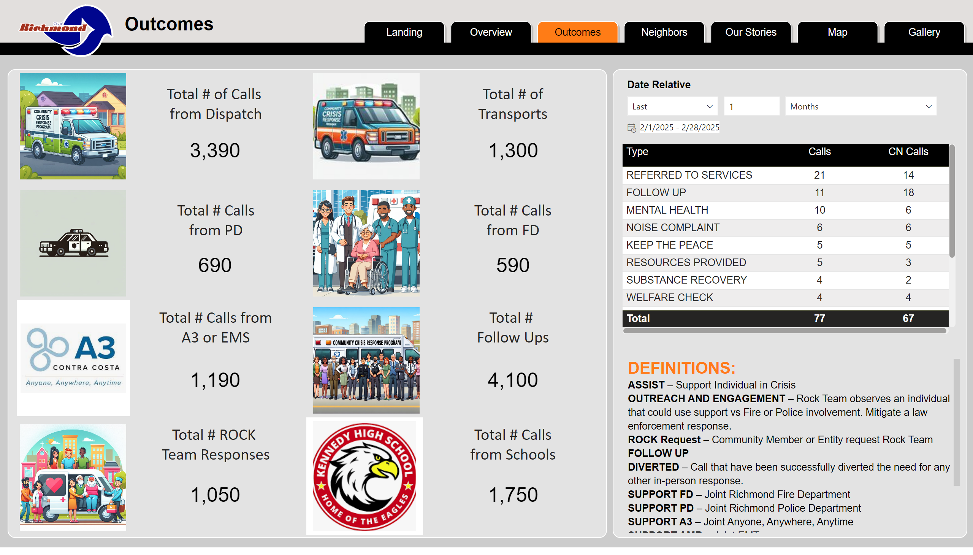
Outcomes
DATA DASHBOARD DRAFT (cont’d)
Notes:
Gold Bar
No alt text provided
pageNavigator
No alt text provided
Header Back
No alt text provided
image
No alt text provided
textbox
No alt text provided
Cap Top
No alt text provided
Cap Top
No alt text provided
About Us Text
No alt text provided
image
No alt text provided
image
No alt text provided
image
No alt text provided
image
No alt text provided
image
No alt text provided
image
No alt text provided
image
No alt text provided
image
No alt text provided
textbox
No alt text provided
textbox
No alt text provided
textbox
No alt text provided
textbox
No alt text provided
textbox
No alt text provided
textbox
No alt text provided
textbox
No alt text provided
textbox
No alt text provided
card
No alt text provided
card
No alt text provided
card
No alt text provided
card
No alt text provided
card
No alt text provided
card
No alt text provided
card
No alt text provided
card
No alt text provided
tableEx
No alt text provided
Date Range
No alt text provided
image
No alt text provided
image
No alt text provided

Slide 8
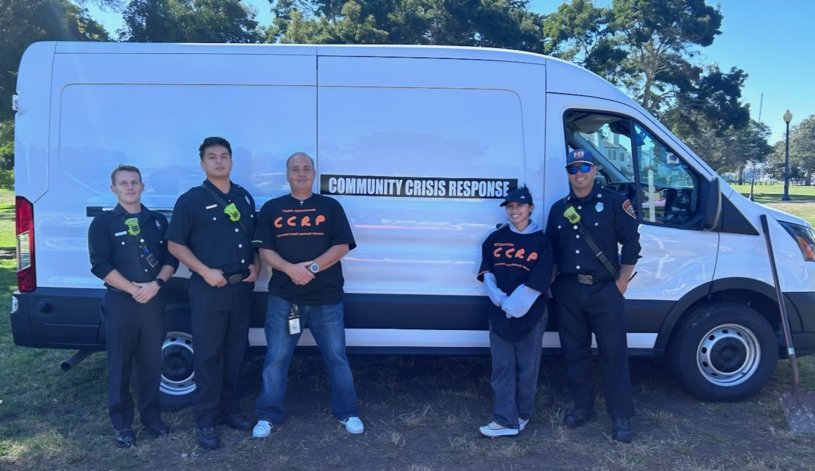
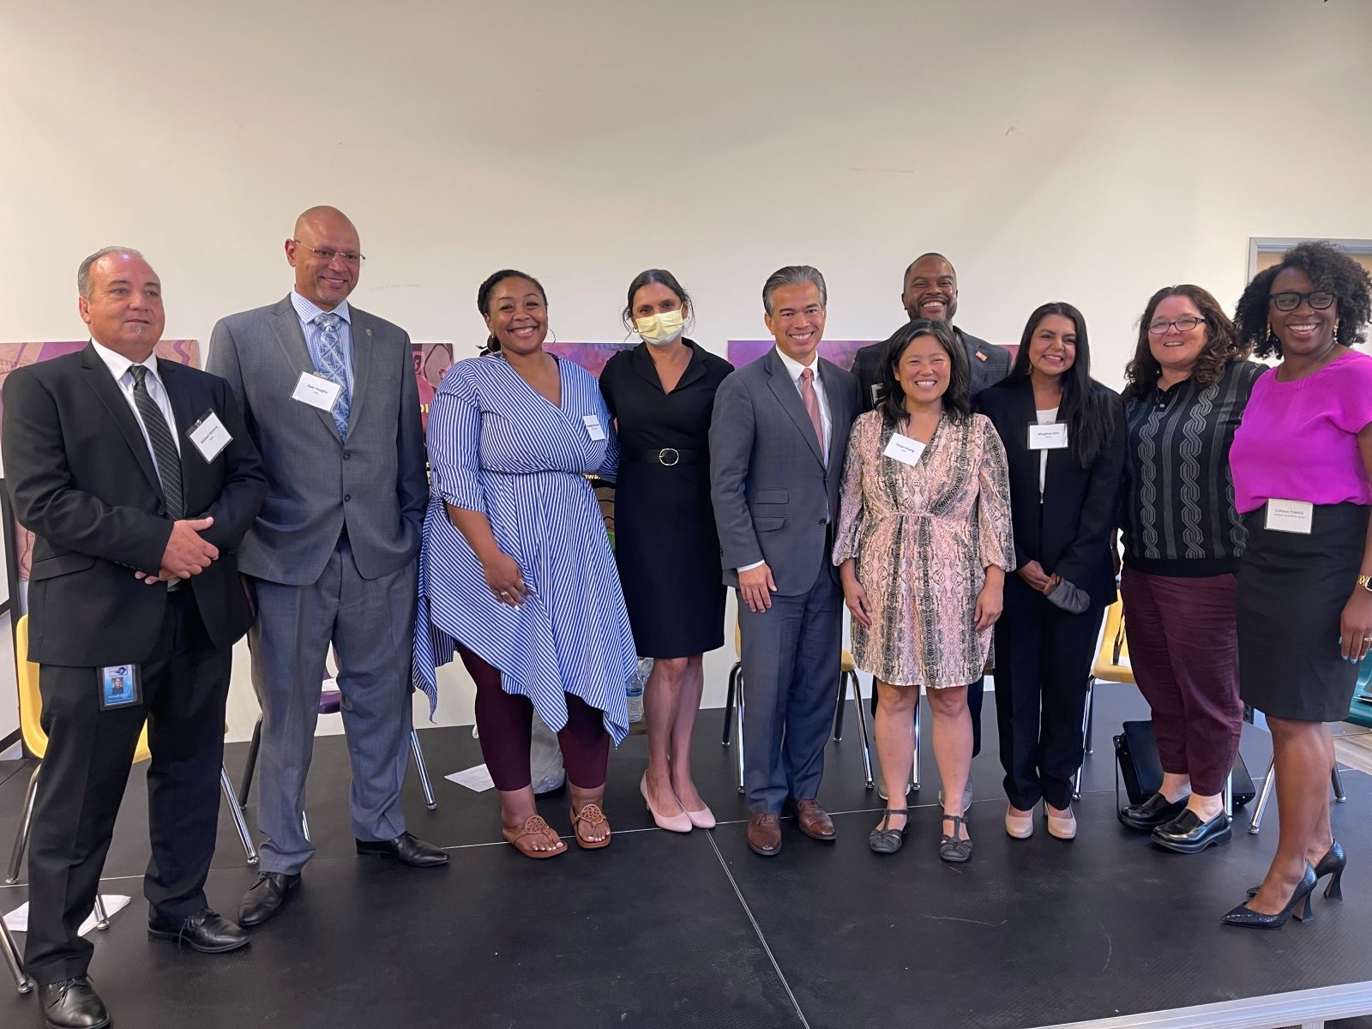
GOALS FOR FY25-26
Hire and onboard 8 Community Intervention Specialists
Complete van wrap and van buildout of mobile crisis response vans
Acquire Back Up Vans to ensure services or outreach are never impacted.
Find office space for the official CCRP homebase
Continue to recruit and appoint CCRP Community Advisory Board members
Develop specially designed protocols for CCRP service call referrals and follow-up
Identify and order the equipment needed
Establish and strengthen referral relationships with community-based service providers
Implement a citywide outreach and public education campaign
Continue to discuss a strong data collection, monitoring, and evaluation system with a focus on impact, outcomes, and efficacy
CCRP Program Manager and Associate Admin Analyst with Captain Tapia and RFD officers at Richmond’s Family Day
August 2024
RYSE Hosted Panel with AG Rob Bonta on Public Safety

Slide 9
POSITIONS
 | FY2023-24 Approved Positions | FY2024-25 Proposed Positions
Total Positions | 11 | 11

Slide 10
FISCAL YEAR 2024-25
PROPOSED BUDGET

