Slide 1

New Councilmember Orientation
OFFICE OF NEIGHBORHOOD SAFETY
Sam Vaughn, Deputy Director
James Houston, Program Manager
May 27, 2025

Slide 2
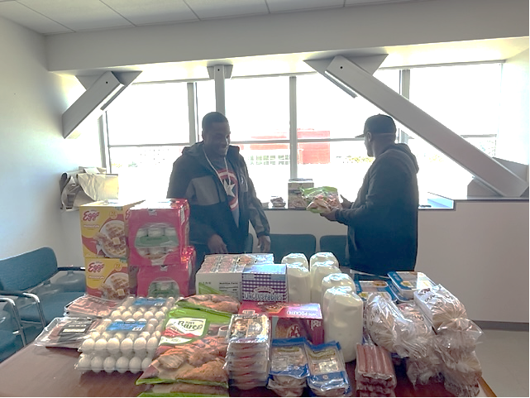
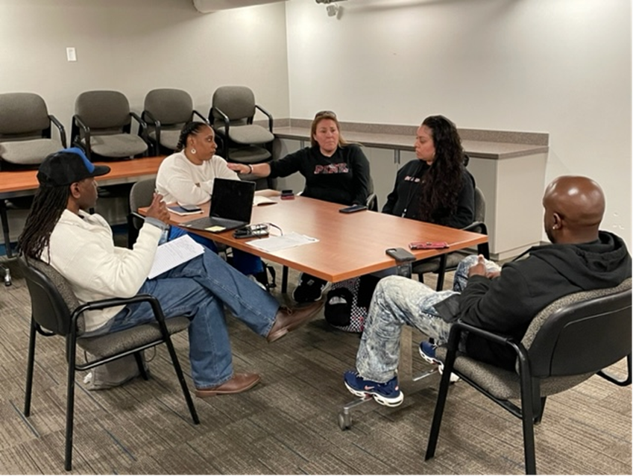
ACCOMPLISHMENTS
IN FY2023-24
• 16,272 contacts with community members most impacted by gun violence
• 22,737 hours spent with community members most impacted by gun violence
• 1,492 service referrals made for community members most impacted by gun violence
• 117 conflicts mediated with community members most impacted by gun violence
• 12 shootings responded to by Neighborhood Change Agents (NCA) in communities most impacted by gun violence
• The Office of Neighborhood Safety was recognized by the City Council on January 16, 2024, as a department and organization that has contributed to reducing the number of homicides in Richmond. In 2023, Richmond had its lowest number of annual homicides (8) dating back to 1971 when such records started being kept.

Slide 3

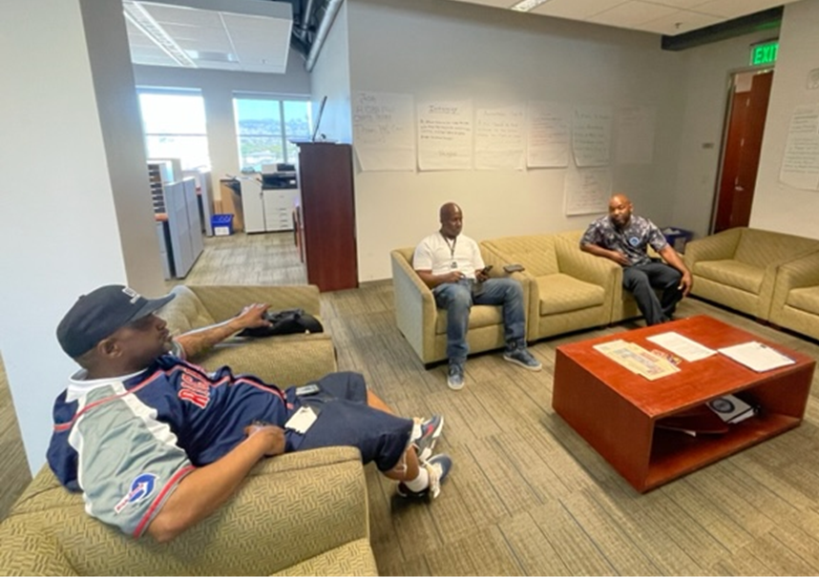
DEPARTMENT
PROGRAM/SERVICES
The primary goal of The Office of Neighborhood Safety (ONS) is to dramatically reduce and one day eliminate gun violence and associated homicides in the City of Richmond. We do this by creating and providing attention, intensive engagement, and support structures that are designed to improve the social and emotional health and wellness of those we serve. Below are the major areas of service in the Department:
Operation Peacemaker Fellowship a non-mandated intensive mentoring intervention designed for youth identified as being at the center of and most impacted by gun violence in the city of Richmond.
Street Outreach when staff go out into the community to connect with people who are at a high risk for gun violence and encourage them to tap into life altering resources and organizations.

Slide 4
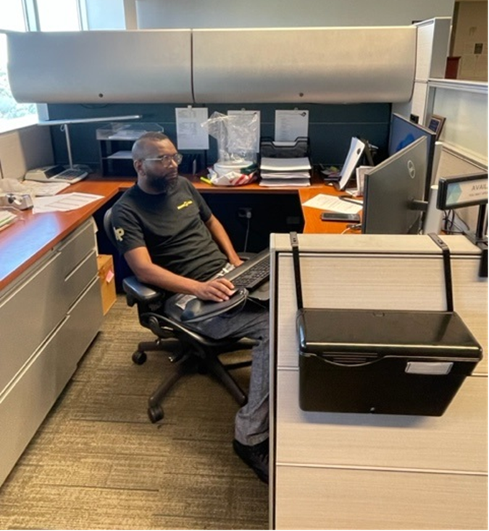
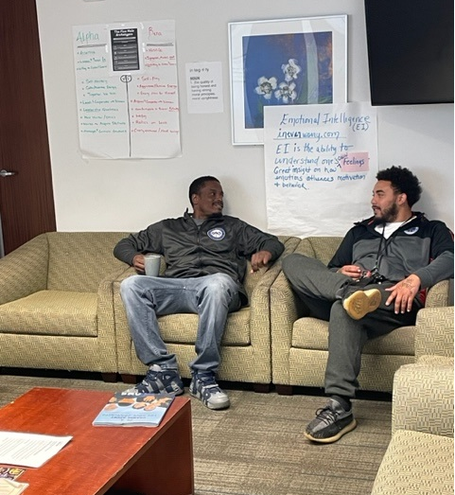
GOALS FOR
FY2025-26
Sustain current reductions in shootings and homicides resulting in injury/death reductions.
Reduce the number of malicious killings of human beings by other human beings from the status quo to zero.
Raise outside resources (approximately $500,000) to continue and expand services.
Continue to do violence prevention with school aged youth

Slide 5

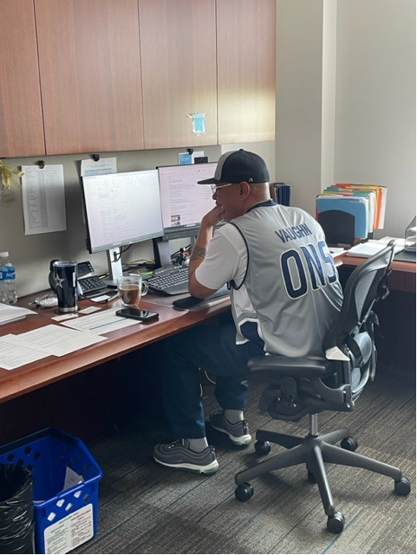
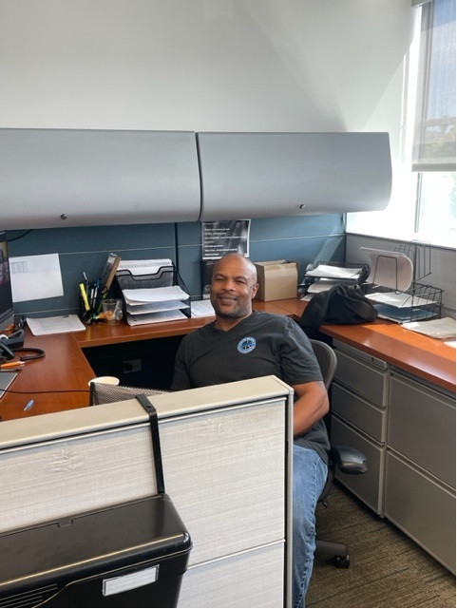
POSITIONS
 | FY2024-25 Approved Positions | FY2025-26 Proposed Positions
Total Positions | 18 | 18

Slide 6
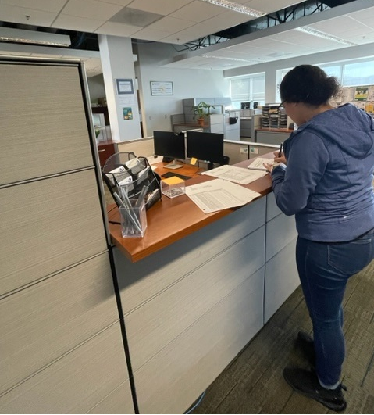
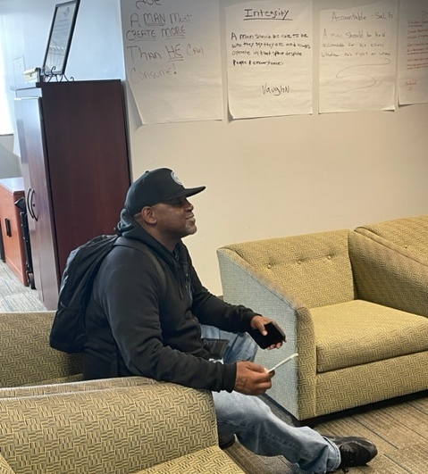
FISCAL YEAR 2025-26
PROPOSED BUDGET

